Slide 1

Intergenerational Trauma: Fostering Healing, Growth, and Resilience With Memory Reconsolidation
Erica Rhoads, MA, LPC, NCC
Liberty University:
Counselor Education and Supervision

Slide 2

Objectives
Participants will be able to describe theories of intergenerational transmission of trauma.
Participants will be informed of the latest research on memory reconsolidation.
Participants will gain resources for memory reconsolidation training for treating trauma.
Notes:
This presentation has the goal of helping you understand and be able to describe how trauma can be transmitted intergenerationally. Both nature and nurture are involved in this process. When working toward treating these trauma memories whether explicit or implicit, memory reconsolidation has show to be an effective treatment. We will discuss the research on memory reconsolidation and how it works to treat trauma. Finally, an example of a treatment will be given and resources for additional training will be provided.

Slide 3

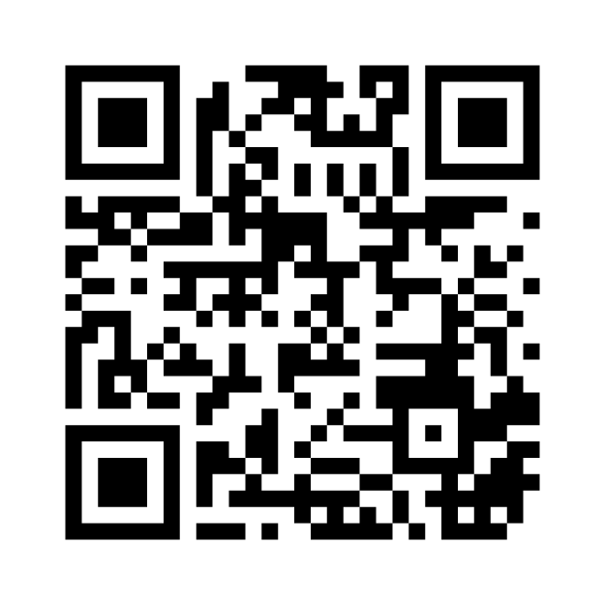
How do you recognize trauma?
Notes:
https://www.menti.com/al44snpfopgn voting code 4879 8736
Need to update Link (only good for two days)
Go to the website and enter your thoughts on how to recognize trauma.
This activity will help you begin to think about how you recognize trauma. What may be accurate and what may be missing? What are some of the key words that your clients are describing as the bring their trauma into a session. (Comment on the words that are being generated and how they relate to the presentation.) Thank you for participating and making this a richer experience.

Slide 4

Recognizing Trauma:
Word Cloud
https://www.menti.com/al44snpfopgn
Notes:
(Share the word cloud created by the audience.
https://www.menti.com/al44snpfopgn
Discuss words and their connection to the presentation. )
Thank you for your input as we begin this topic. As an audience, give me a few examples of how this resonates with the experiences that you have had with people who are feeling the effects of trauma. How many of you feel trapped in your options to help them get to the source of the triggers and eliminate the root of their dysfunction? (Allow the audience to give a few examples and comments, then relate to the presentation. )

Slide 5
Intergenerational Trauma
Possible Signs
Disconnection
Avoiding things
Functioning in dysfunction
Unexplained gender differences
Desire for change
Petion et al., 2022
Notes:
Often intergenerational trauma is not recognized, but more felt. People might notice feelings of disconnection even while being involved in their community. They may avoid certain things, people, or places and yet not understand why they do. They may notice they are functioning in a dysfunctional environment: surviving, but not thriving. They may notice unexplained gender differences in their families’ roles that seem to not make sense and yet they continue from generation to generation. Maybe there is a compelling desire for a change in the homeostasis of their home and family. Each of these could be a sign that intergenerational trauma is present and being passed along unconsciously.

Slide 6
Intergenerational Trauma
Possible Symptoms
Anxiety
Depression
Dysthymia
Hypervigilance
Aktar et al, 2019; Petion et al., 2022
Notes:
While the previous slide described some of the perceptions of the individual, they may present for treatment with symptoms of anxiety, depression, dysthymia, and hypervigilance among other possible noticeable symptoms. While treating the symptoms may work for a temporary solution, when environmental triggers throw them back into their emotional dysregulation, the need to get to the root of the problem is important. Digging deeper into each client’s experience and looking at genograms and other stories that may be told in the families can be ways to identify intergenerational trauma histories.

Slide 7

Nature vs Nurture
Epigenetics
Mirror Neurons
Changes in the genetic coding due to trauma
Neural pathways for learning
Yehuda & Lehrner, 2018; Gaensbauer, 2011; Tan et al., 2019
Notes:
To explain some theories of how intergenerational trauma occurs, we can look at epigenetics and mirror neurons. When an individual experiences trauma, the body reacts with protective measures often referred to as fight or flight, freeze or fawn. When these reactions are triggered by either a single significant trauma or continued traumatic stressors, the body notices the pattern and begins to modify the DNA that regulates when certain genetic expressions are on or off. These then are passed on to the next generation. While they can be reversed over time, often the effort to do so is great.
Additionally, mirror neurons explain how young children implicitly learn from their caregivers even pre-verbally. If you have ever held a baby and looked into their face, it’s almost automatic to begin mimicking each other. The baby notices cues from the caregiver and learns about emotions, expectations, and the world all using the mirror neurons to create pathways. When a caregiver has experienced significant trauma, their expressions, reactions, and emotions are subtly passed on to the child.
These two ways of “learning” shape and mold the developing child and direct their choices of how to respond to the world. Is it a dangerous place full or fear or a place of safety where exploration and security can happen.

Slide 8

Faulty Compass
Process Previous Trauma
Avoid Difficult Emotions
Out of Habit
Maintain Coherent View
Visser & Arntz, 2023).
Notes:
For those who believe it is a dangerous place, a faulty compass may develop setting in patterns that appear maladaptive, but make sense to the individual.
Visser and Arntz take an emotional memory perspective view of people who choose maladaptive situations based on their trauma history. They hypothesize that due to a faulty compass, so to speak, people often put themselves in familiar situations reflective of their trauma. The first hypothesis is by putting themselves in a negative situation again to process the previous trauma as a way to help the individual attempt to repair or retrospectively master previous negative situations. With this mastery, the belief is that the feeling of helplessness can be changed to one of empowerment. Second, they may choose these environments due to old habits and a desire to avoid surprises. While the situation may be negative, the fear of unpredictability and loss of a sense of control can keep them in negative situations. Next, they propose that people have a self-view of how they see themselves in relation to their environment. They may believe that to stay true to these beliefs, staying in negative situations is inevitable. Finally, by choosing to stay within the familiar, difficult emotions are avoided.

Slide 9

How do we Foster Healing, Growth, and Resilience?
Memory Reconsolidation Treatments
Eye Movement Desensitization and Reprocessing (EMDR)
Emotion-Focused Therapy (EFT)
Coherence Therapy
Interpersonal Neurobiology (IPNB)
Ecker & Bridges, 2020; Ecker & Vaz, 2022; Henderson et al., 2021;Post & Kegan, 2017
Notes:
To counter these maladaptive patterns and behaviors, processing the trauma and installing healthy beliefs can allow the brain’s malleability to change in a more adaptive way. The activation of emotions is a portal to our memories and beliefs about the world, whether past or present. For those familiar with the movie Inside Out, a peak into the inner workings of our brains show a number of parts and processes that are involved with memory storage. When memories, specifically emotionally salient memories become stuck, treatments such as EMDR, EFT, Coherence Therapy, and IPNB are all ways at taking those core memories and sending them off to long terms storage as the emotions in Inside Out demonstrated. Thus, allowing for the individual to live by a healthier view of the world without the stressors of emotional triggers flooding them with dysregulation.
Additionally, spiritual and cultural adaptations are appropriate and helpful to integrate into these treatments. For example, using a spiritual higher power as a resource when processing trauma, using scripture to create visual imagery of safety, providing culturally relevant examples and supports for clients.

Slide 10

How does Memory Reconsolidation Work?
Memories
Stored
Synaptic Connection
Memory is Updated
The brain makes synaptic connections in our neural network
Our memory is constantly updated with new experiences
Our nervous system receives and stores memories
Notes:
Our nervous system is the sole entrance for our memories to enter the brain. The nervous system is connected to all parts of our body. We often take in information through all of our senses and feel our emotions in our bodies. The neural networks that are created store memories through synaptic connections. Often things that happen simultaneously are stored together…”neurons that fire together, wire together” creating stronger memories. As we continue to experience life, new information updates our memory. When two types of information are incongruent, our brain works to make sense of the incongruency and updates the pathways.

Slide 11

Long Term Memories Can Change
Fragile
Unstable
Altered
Altered in Short Term Memory
Subject to change
Edit and Rebuild
Ecker & Bridges, 2020; Ecker & Vaz, 2022; Post & Kegan, 2017
Notes:
When memories are brought up into short-term memory, they become fragile and unstable. By bringing up this impressionable memory and giving it the opportunity to change, neurons can literally grow new branch connections to other neurons changing the way our memories are connected to strong emotions. Rather than reliving our trauma memories and being triggered by a flood of dysregulating emotions, the fear response can effectively be erased. Memory reconsolidation provides a guided session that gently brings long term memories into short term memory during a supportive, calm state allowing for the separation of sensation and experience, extinguishing the old feelings and replacing with new desired feelings, editing the responses and building new neural pathways. Changes are often noticed within one to three days. While the memories are still intact, the emotions and dysregulation once connected to them are no longer experienced.

Slide 12

Reconsolidation of Traumatic Memories (RTM)
Gray et al., 2019, 2021
Notes:
Using the theory that there is a five-hour window to reprocess memories and allow for revising, reversing, or eliminating long-term memories associated with trauma techniques such as Reconsolidation of Traumatic Memories may bring relief to many who are holding on to trauma. Even trauma that they are not able to put in context, but often have strong emotional reactions attached.

Slide 13
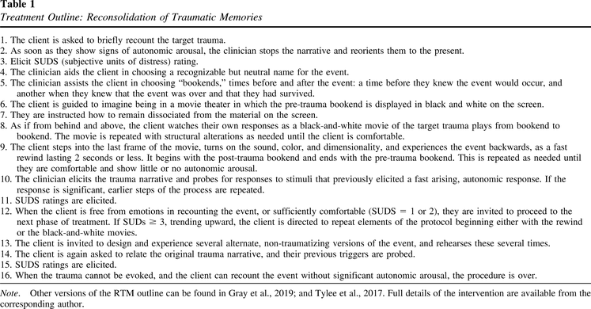
Reconsolidation of Traumatic Memories (RTM)
https://randrproject.org/training.html
Gray et al., 2019, 2021
Notes:
This therapy is an example of memory reconsolidation treatment. Training is available at the R and R project.org website. The steps outlined include a few main elements that will be highlighted on the next slide. It is recommended to have training and supervision before attempting to use this protocol.

Slide 14



Process
Calm Safe Space Before Traumatic Event
Target Traumatic Event
Rewind the “Movie”
Gray et al., 2019, 2021
Notes:
As more fully described in the previous slide, Reconsolidation of Traumatic Memories has six main elements that may be repeated and adjusted as necessary. They include (1) a brief narrative of the trauma event including the emotions and visceral feelings associated with the event (2) name the event and identify a clear beginning and end (3) a disembodied self, viewing a high-speed, black-and-white movie in an imaginal theater from the perspective of the projection booth, observing their disembodied self watch the movie; (4) the structure of the movie is modified until heightened arousal is extinguished; (5) then processing the “film” as a backward experience of the event, as if the whole event were undoing itself; and (6) finally a version the event is rescripted and practiced by the client using visual imagery. The client does not reexperience the full impact of the traumatic memory. The therapist stops the memory recall at their first observations of autonomic arousal (e.g., tearing, tensing, flushing, sweating, breathing changes).

Slide 15

Thank you
Erica Rhoads
570-620-6970
erhoads@liberty.edu
www.ericarhoads.com
Resources:
https://randrproject.org/training.html
https://www.coherencetherapy.org/index.htm
https://ny.pbslearningmedia.org/resource/nvfb-sci-memhackers/wgbh-nova-memory-hackers-full-length-broadcast/
Notes:
For additional information or a copy of the slides, please feel free to email me or check out my website. Thank you so much and I would love to hear any questions or comments about the presentation. A link to the website of the Reconsolidation of Traumatic Memories protocol is available on the slide as well. Bruce Ecker’s website has Coherence Therapy. Org is another wealth of information on training and workshops for memory reconsolidation. For more information on memory and the science behind neural malleability, the PBS Memory Hackers on NOVA is interesting.

Slide 16
References
Aktar, E., Van Bockstaele, B., Pérez, E. K., Wiers, R. W., & Bögels, S. M. (2019). Intergenerational transmission of attentional bias and anxiety. Developmental Science, 22(3), 1–19. https://doi.org/10.1111/desc.12772
Ecker, B., Bridges, S.K. (2020). How the science of memory reconsolidation advances the effectiveness and unification of psychotherapy. Clinical Social Work Journal, 48, 287–300. https://doi.org/10.1007/s10615-020-00754-z
Ecker, B., & Vaz, A. (2022). Memory reconsolidation and the crisis of mechanism in psychotherapy. New Ideas in Psychology, 66, 1–11. https://doi.org/10.1016/j.newideapsych.2022.100945
Gaensbauer, T.J. (2011). Embodied simulation, mirror neurons, and the reenactment of trauma in early childhood. Neuropsychoanalysis, 13(1), 91-107. https://10.1080/15294145.2011.10773665
Gray, R., Budden-Potts, D., & Bourke, F. (2019). Reconsolidation of Traumatic Memories for PTSD: A randomized controlled trial of 74 male veterans. Psychotherapy Research, 29(5), 621–639. https://doi.org/10.1080/10503307.2017.1408973
Gray, R. M., Budden-Potts, D., Schwall, R. J., & Bourke, F. F. (2021). An open-label, randomized controlled trial of the reconsolidation of traumatic memories protocol (RTM) in military women. Psychological Trauma: Theory, Research, Practice, and Policy, 13(6), 641–651. https://doi.org/10.1037/tra0000986
Henderson, Z. R., Stephens, T. N., Ortega-Williams, A., & Walton, Q. L. (2021). Conceptualizing healing through the African American experience of historical trauma. American Journal of Orthopsychiatry, 91(6), 763–775. https://doi.org/10.1037/ort0000578

Slide 17
References
Petion, A. R., Chang, C. Y., Brown-Thompson, C., Mitchell, M. D., Grinnage, D., & Huffstead, M. E. (2023). “Battling something bigger than me”: A phenomenological investigation of generational trauma in African American women. Journal of Counseling & Development, 101(1), 69–83. https://doi.org/10.1002/jcad.12454
Post, R. M., & Kegan, R. (2017). Prevention of recurrent affective episodes using extinction training in the reconsolidation window: A testable psychotherapeutic strategy. Psychiatry Research, 249, 327–336. https://doi.org/10.1016/j.psychres.2017.01.034
Rogel, A., Loomis, A. M., Hamlin, E., Hodgdon, H., Spinazzola, J., & van der Kolk, B. (2020). The impact of neurofeedback training on children with developmental trauma: A randomized controlled study. Psychological Trauma: Theory, Research, Practice, and Policy, 12(8), 918–929. https://doi.org/10.1037/tra0000648
Tan, K. M., Burklund, L. J., Craske, M. G., & Lieberman, M. D. (2019). Posttraumatic stress disorder and the social brain: Affect‐related disruption of the default and mirror networks. Depression and Anxiety, 36(11), 1058–1071. https://doi.org/10.1002/da.22953
Visser, R. M., & Arntz, A. (2023). A faulty compass: Why do some people choose situations that are not good for them? Journal of Behavior Therapy and Experimental Psychiatry, 78, 1–7. https://doi.org/10.1016/j.jbtep.2022.101793
van der Kolk, B. A. (2014). The body keeps the score: Brain, mind, and body in the healing of trauma. Viking.
Yehuda, R., & Lehrner, A. (2018). Intergenerational transmission of trauma effects: Putative role of epigenetic mechanisms. World Psychiatry, 17(3), 243–257. https://doi.org/10.1002/wps.20568

