Slide 1

COUC 505
Theories & Spiritual Integration
Week 13
Erica Rhoads
Professor
Liberty University

Slide 2


Slide 3

Learning Objectives
Identify current trends in using theory in counseling practice.
Explain the importance of presence in developing counselor competence.
Understand the influence of basic counseling skills on theoretical approaches.
Recognize the importance of integrating spirituality into counseling.

Slide 4
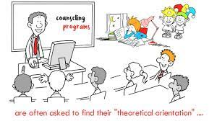
Theory Vs Technique
https://www.youtube.com/watch?v=S3yBPuf46Jo

Slide 5
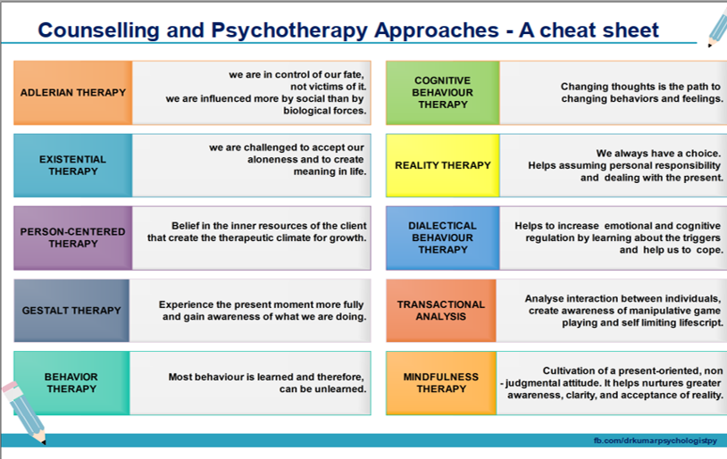

Slide 6
Spiritual Focused Strategies: An Overview
Research shows that “secular” counselors often ignore spiritual concerns, treat spiritual beliefs & experiences as pathological, fail to comprehend spiritual language & concepts, assume that religious counselees share the cultural norms of non-faith people, and recommended strategies that might be immoral or discredit religious faith

Slide 7

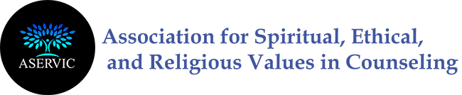
ASERVIC
https://aservic.org/

Slide 8


Slide 9
Spiritual Integration Begins with You
Integration of psychotherapy with religion & spirituality has been an active enterprise since the establishment of psychology as an independent discipline during the 19th century
Key to integration is the personal character of the counselor
Each counselor must understand his/her own attitudes toward Christian topics, moral issues, key doctrinal beliefs, & relevant theological issues

Slide 10
The Psychological & Spiritual Functioning Relationship
Underneath one’s knowledge of his/her faith experience are psychological & neuropsychological processes that influence how one relates & experiences God
Each person internalizes representations of the self, others, & God around the themes of felt security & love
  Stored in the limbic system
  Internal working models develop into a general attachment style & reflect a person’s early attachment experiences with primary caregivers

Slide 11
Spiritual & Psychological Relationship (cont)
  Much of what we experience or know viscerally (deep down, intuitively in the body) are based on internalizations that were conceived during pre-verbal phases of development, encoded as neurobiological data in the limbic system, & elaborated on or solidified throughout later development
  People who develop a secure attachment style have more adaptive schemas (deep beliefs), and neurobiological networks that reflect trust in self, others, & God
  Insecurely attached develop maladaptive schemas, and neurobiological networks that reflect mistrust in self, others, & God
  These schemas are relatively stable throughout life

Slide 12
Spiritual & Psychological Relationship (cont)
The bottom line is that what people experience in their relationship with self, others, & God are from the template of unconscious, internal working models
People with insecure attachment tend to perceive God as controlling, less accepting, nurturing & distant

Slide 13
Ethical Issues in Spiritual Integrated Counseling
You are free to utilize spiritual integration providing:
  You have completed a bio-psycho-social-spiritual assessment
  Counselee has expressed a desire to utilize faith in counseling
  Counselee fully understand particular interventions, rationale for them, & given consent
  Interventions are congruent with counselee’s religious/spiritual belief system

Slide 14
Ethical Issues (cont)
  You have adequate training in cultural, ethnic, & religious/spiritual diversity
  You & your counselee have developed a trusting & empathic relationship
  You have determined that the counselee is not psychotic or delusional
  You & your counselee believe that these interventions have relevancy to the issues, concerns, & goals

Slide 15
Spiritual Assessment:
Spiritual Life Map – a chronological, illustrated account of a person’s relationship with God from birth
Letter to God – share true thoughts, feelings, questions, concerns, requests, etc in relation to God; no right or wrong responses
Attachment with God Experiential Survey – taps into the person’s internal experience of God

Slide 16
Collaboration with Spiritual Community
Involvement with a healthy religious community is associated with health & well-being
We can, & sometimes we should consult with counselee’s religious/spiritual leaders
When leaders are healthy people who are available to support counselee, provide guidance, & comfort a collaborative relationship is important

Slide 17
Current Standard of Practice in
Counseling
Person of the Therapist and the Therapeutic Relationship
Specific Therapies
Psycho-Education
Long Term Therapy
After Care and Relapse Prevention
Bio-Psycho-Social-Spiritual
Assessment
Thomas, J.C., & Sosin, L. (2011). Therapeutic expeditions: Preparing the Christian counselor for the journey. Nashville, TN: Broadman & Holman.

Slide 18
Wrap Up
Thoughts/Concerns
Announcements/Clarifications

