Slide 1
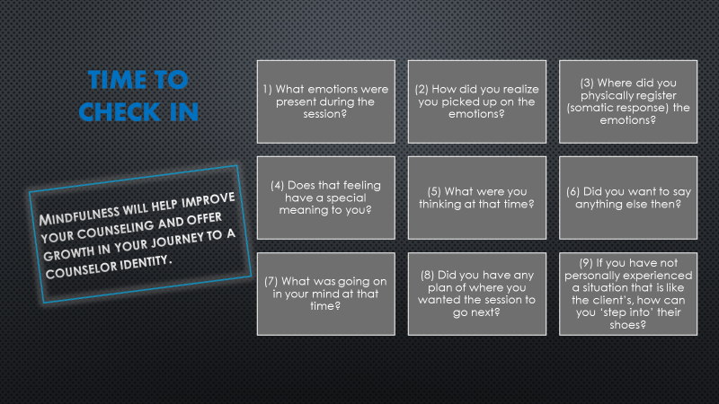
Notes:
10- Minutes

Slide 2
COUC 505 Techniques & The Helping Profession
Week 8: Challenging Skills
Erica Rhoads, MA, NCC
Professor
Department of Counselor Education & Family Studies
Liberty University
Notes:
12:10

Slide 3
Learning Objectives
Identify inconsistencies in the client’s story that need to be challenged
Understand how to respond to client discrepancies
Evaluate use of immediacy
Practice and assess your competency
Notes:
12:11

Slide 4
Challenge: Biblical Example
Nathan Rebukes David (II Samuel 12)
But God was not at all pleased with what David had done, and sent Nathan to David. Nathan said to him, “There were two men in the same city—one rich, the other poor. The rich man had huge flocks of sheep, herds of cattle. The poor man had nothing but one little female lamb, which he had bought and raised. It grew up with him and his children as a member of the family. It ate off his plate and drank from his cup and slept on his bed. It was like a daughter to him.
⁴ “One day a traveler dropped in on the rich man. He was too stingy to take an animal from his own herds or flocks to make a meal for his visitor, so he took the poor man’s lamb and prepared a meal to set before his guest.”
⁵⁻⁶ David exploded in anger. “As surely as God lives,” he said to Nathan, “the man who did this ought to be lynched! He must repay for the lamb four times over for his crime and his stinginess!”
⁷⁻¹² “You’re the man!” said Nathan. “And here’s what God, the God of Israel, has to say to you: I made you king over Israel. I freed you from the fist of Saul. I gave you your master’s daughter and other wives to have and to hold. I gave you both Israel and Judah. And if that hadn’t been enough, I’d have gladly thrown in much more. So why have you treated the word of God with brazen contempt, doing this great evil? You murdered Uriah the Hittite, then took his wife as your wife. Worse, you killed him with an Ammonite sword! And now, because you treated God with such contempt and took Uriah the Hittite’s wife as your wife, killing and murder will continually plague your family. This is God speaking, remember! I’ll make trouble for you out of your own family. I’ll take your wives from right out in front of you. I’ll give them to some neighbor, and he’ll go to bed with them openly. You did your deed in secret; I’m doing mine with the whole country watching!”
¹³⁻¹⁴ Then David confessed to Nathan, “I’ve sinned against God.”
Notes:
12:13-16 Ask for student volunteer to read

Slide 5
Challenge & the Bible
Now I am confident concerning you, my brethren, that you are full of goodness, filled with all knowledge, able to admonish one another. (Romans 15:14)
That we should no longer be children tossed to and fro … but, speaking the truth in love, may grow up in all things into Him who is the head – Christ. (Ephesians 4:14–15)
If your brother or sister sins go and point out their fault, just between the two of you. (Matthew 18:15)
Brothers and sisters, if someone is caught in a sin, you who live by the Spirit should restore that person gently. (Galatians 6:1)
What challenging is NOT:
Opposing the client (Meier & Davis, 2008), going against the client (Ivey et al., 2010)
Showing anger, coming to blows with the client (Morrison, 2008)
Being direct and harsh with the client (Ivey et al., 2010)
Telling the client the ways they need to change (Sommers-Flanagan & Sommers-Flanagan, 2014)
Notes:
12:16-12:20

Slide 6
Skill 10: Challenge
Operating on misinformation about the self
Misinterpreting the actions of others
Blaming others rather than examining themselves
Inconsistent in behavior, thoughts, feelings, and values
Reminds the client that this is not a friendship but a business partnership.
Goal: reveal convenient delusions that enable them to function AND to help them become reality based.
Notes:
12:20-12:22

Slide 7
Challenge Discrepancies Between…
Verbal & Non-verbal messages
beliefs & Experiences
values & behavior
experiences & plans
incongruity between 2 verbal messages
Notes:
12:23-12:25 Values & Behaviors: A client who repeatedly says he doesn’t have an “alcohol” problem and feels that this kind of behavior is deplorable. YET, he will go to grocery store, buy a bottle of wine and drink the entire thing in the parking lot and drive home.

Slide 8
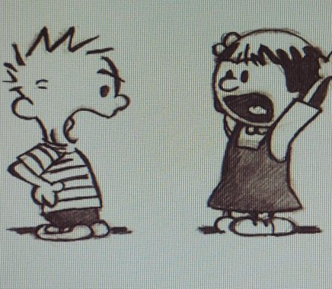
Watch Clip
https://youtu.be/iNHIGD9prus
Notes:
12:25-33 Discuss Clip

Slide 9


What are the risks of using challenge?
Damage therapeutic alliance
Client may feel angry, tricked, trapped, rejected, defensive
Client may be less cooperative or resistant to counseling
  The client may not deal fully with their feelings or problems after confrontation
Motivational interviewing cautions against confrontation because:
  Counselor imposes mindset on client
  Can harm client
  Judgmental mechanism; Client might feel attacked.
(Ivey et al., 2010; Kottler, 1993; Morrison, 2008; Sommers-Flanagan & Sommers-Flanagan, 2014;
Thomas & Sosin, 2011)
Notes:
12:33-12:35

Slide 10
What are the multicultural issues related to challenging?
If the client is different in terms of multicultural variables (e.g., race, age, gender, social status), challenging can be more difficult
Confrontation can be offensive to some cultures
  Asian, Native American, Latina/Latino
For some cultures, silence can be effective
  Inuit, Native American
(Ivey et al., 2010)
Notes:
12:35-36

Slide 11

Types of Challenging
Feedback
  Providing information and your honest reaction
Confrontation
  Providing discrepancies and asking for resolution
  Care-fronting: the counselor genuinely cares for the client while also wanting to help the client grow (Thomas & Sosin, 2011)
Notes:
12:36-37

Slide 12
Challenge: Feedback
Not typically welcomed
Essential because:
  Key to self-awareness & growth
  Enables client to confront personal inconsistencies & see how their attitudes are affecting others
  Consistent with God’s Word
Notes:
12:37-38

Slide 13
Feedback Guidelines
Ask permission before.
Avoid feedback on personality traits: focus on action, not person.
Be specific, concrete, and non-judgmental.
Sometimes offer it tentatively.
Give only one or two pieces at a time.
Emphasize client’s strength, use the sandwich method.
Observe the client’s reaction to see how it was received
Notes:
12:38-40 What would be a “personality trait” feedback? “You seem to be an angry person.” “I’ve noticed that Your Strong since of pride creates conflict for you.”
Remember that these kinds of interventions will be those you have “thought through” or have “recognized in pervious sessions”, so don’t become alarmed that you will not be able to do this.

Slide 14
Giving Feedback: One Format
“On the one hand, (list client’s behavior, attitude, value, etc.), while on the other hand, (cite contradictory behavior, attitude, value, etc.)”
Let the client resolve the discrepancy
  “How do you put these two together?”
Notes:
12:41-45 Example: I have asked a client to use the “thought log”, to track what happens, his thoughts and then his feelings each time he feels discriminated against. However, for three weeks you and he have agreed that it would be good but he never does it.
“Can I share with you an observation? Yeah. We have been talking about how this thought log could help you examine these “things that happen” that cause you to “think people are discriminating against you”, and then “how that actually makes you feel”, but each week there is some kind of reason you never do this. Can you help me understand why this never happens?

Slide 15
Examples of Feedback
“Last week, for homework, you agreed to track your angry outbursts between sessions, but then did not do it because you said you were too busy at work. Now this week you are telling me you also did not do any tracking even though you said you would. On the one hand you say you want to work on your anger but on the other, you haven’t actually done any tracking.”
“You said you were hurt that you had lost your job. But as you told me that, you laughed. That seems incongruent.”
Notes:
12:46

Slide 16
Or you can use this format that combines skills you have already learned:
“I hear you saying that the conflict between you and your wife has been worse lately. You’re feeling frustrated and stuck. On one hand, you would like to improve the relationship, but on the other hand, it sometimes feels like there has been too much damage done to repair things.”
Paraphrase
Reflection of feeling
Summarize discrepancy
(Ivey et al., 2010)
Notes:
12:47-48

Slide 17
Challenge Meets Empathy
Empathy must PRECEDE confrontation rather than follow it to increase the likelihood of receptivity.
Jesus looked at the man and loved him... “one thing you lack...” (with the Rich Young Ruler)
Notes:
12:49

Slide 18
Challenge: Confrontation
Helps the client look at thoughts and behaviors that might be self-defeating or harmful.
A form of challenge and not a verbal assault.
Offered as a high level of empathy.
Typically to address a client’s incongruence or discrepancy.
Notes:
12:50

Slide 19
Challenge with Support Examples
Client: (Smiling) It makes me so angry to even think about what he did to me.
Counselor: I imagine you did feel angry. When you talk about it I noticed you are smiling. What happens if you let your body express that anger?
Client: (Screaming) Ahhhhhh!!! It really makes me angry that he did that to me!!! (Laughing). Wow. That felt good!
Counselor: (Smiling) That's a start. Maybe in the future we can concentrate on doing that in the moment, when the feeling is immediately coming out.
Client: (Tearful) I'm not sure. I'm a little afraid. Anger scares me. It reminds me of when my father used to get angry when I was a little girl. . .
Notes:
12:52

Slide 20
Potential Client Outcomes/Responses
Push the client towards new behavior
Disrupt patterns of sinful or unhelpful thinking or attitudes
Challenge them to act on their own knowledge and values
Help them consider more seriously a different option
Change the topic
Discredit the counselor
Falsely accept the challenge
Deny the problem
Notes:
12:53-55

Slide 21
BREAK TIME – 15 Minutes
Watch clip during your break (start at 21 minutes)
Prepare to discuss afterward
http://ezproxy.liberty.edu/login?qurl=https://video.alexanderstreet.com/watch/motivational-interviewing/clips/9590?account_id=12085&usage_group_id=101906
Notes:
12:55-1:10 Share clip in chat

Slide 22
Challenging
Very powerful technique
May lead clients into material that is much more emotionally laden and difficult to express.
Timing is always important with respect to the development of a therapeutic trust, as well as the client's ability to handle advanced techniques with respect to his or her progress in counseling.
Challenging is not an effective tool in the initial stage of counseling – build rapport first
Assess the client’s readiness to deal with the specific material being confronted.
Notes:
1:10-1:15 Discuss video clip and connect to points

Slide 23
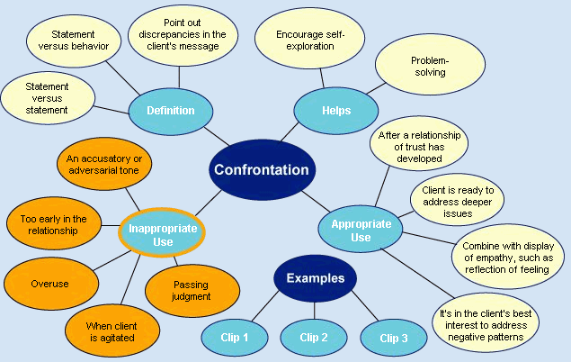
Notes:
1:15-1:20 Have students take a branch to explain.
Share additional Clips for Break
http://ezproxy.liberty.edu/login?qurl=https://video.alexanderstreet.com/watch/motivational-interviewing/clips/9590?account_id=12085&usage_group_id=101906

Slide 24

Now let’s practice…
Use worksheets from email.
Notes:
1:20-1:35 Put students in breakout rooms to practice

Slide 25
What is immediacy?
When counselor tells client their reactions (personal and immediate) (Thomas & Sosin, 2011).
“It involves a counselor’s understanding and communicating of what is going on between the counselor and the [client] within the helping relationship, particularly the [client’s] feelings, impressions, and expectations, as well as the needs of the counselor” (Thomas & Sosin, 2011, p. 213)
Counselor’s thoughts, feelings about what is happening in the counseling relationship. Can be positive or confrontational.
  “As I sit with you and listen to you discussing the pain you’re feeling from the loss of your mother, I feel very moved.”
  “You say that you want to be close to others, and yet when I asked you about that just now, you seemed to dismiss me with using humor and sarcasm.”
Notes:
1:35-1:40 Discuss practice and then introduce immediacy.

Slide 26
Why is it important for you to know what you’re feeling during a session?
The ability to identify and monitor your feelings is an important aspect of effectively communicating them to the client.
A direct but moderated expression of feeling can help a client effect change.
Regardless of your reaction to a client’s statement(s), the counselor’s response must always be respectful of the client and the counseling process.
(Evans, Hearn, Uhlemann, & Ivey, 2017)
Notes:
1:40

Slide 27
Relationship Immediacy
Relationship immediacy: discussing the counseling relationship
  Way you and client are interacting
  How counseling relationship has evolved (Thomas & Sosin, 2011)
  Repairing ruptures
    “As I sit with you, I get the sense that you are angry with me because of what I just said. I’m glad that you’re comfortable letting me know that, because I care about how we are doing together in our counseling work.”
  “At this moment, what might be your thoughts about how the two of us are doing?” “What are you feeling and thinking at this very moment?”
  Ivey et al., 2010, p. 207
Notes:
1:42-1:45

Slide 28
When to Use Immediacy
These situations give rise to the effective use of immediacy responses by counselors:
When differences in age, gender, race, viewpoints, religion, and/or socioeconomic background affect the degree of compatibility between the counselor and the client
When you notice tension between you and the client
When something is blocking the progress (e.g., when the client seems to be competing with the counselor)
When immediacy responses can establish trust between the counselor and the client
When immediacy responses can reduce a client’s overdependence on the counselor to solve problems
During the initial and final stages of a relationship with a counselor, when clients frequently experience some discomfort including separation anxiety.
Evans, Hearn, Uhlemnn, & Ivey, 2017 & Thomas & Sosin, 2011:
Notes:
1:46-48

Slide 29

Discussion: Questions/Comments
Identify inconsistencies in the client’s story that need to be challenged
Understand how to respond to client discrepancies
Evaluate use of immediacy
Practice and assess your competency
Notes:
1:48-55

Slide 30
Something to Ponder
When your client leaves your office after the first session and calls their best friend to describe their experience with you, in one sentence, what do you most hope he/she will say?

Slide 31
References
Ivey, A. E., Ivey, M. B., & Zalaquett, C. P. (2010). Intentional interviewing and counseling: Facilitating client development in a multicultural society (7th ed.). Belmont, CA: Brooks/Cole.
Kottler, J. A. (1993). On being a therapist (Revised ed.). San Francisco, CA: Jossey-Bass.
Meier, S. T., & Davis, S. T. (2008). The elements of counseling (6th ed.). Belmont, CA: Thompson Brooks/Cole.
Morrison, J. (2008). The first interview (3rd ed.). New York, NY: Guilford Press.
Sommers-Flanagan, J., & Sommers-Flanagan, R. (2014). Clinical interviewing (5th ed.). Hoboken, NJ: John Wiley & Sons.
Thomas, J. C., & Sosin, L. (2011). Therapeutic expedition: Equipping the Christian counselor for the journey. Nashville, TN: B&H Publishing.
Yalom, I. D. (2002). The gift of therapy: An open letter to a new generation of therapists and their patients. New York, NY: HarperCollins.
Young, M. E. (2013). Learning the art of helping: Building blocks and techniques (5th ed.). Upper Saddle River, NJ: Pearson Education.

