Slide 1

Krumboltz's Career Theories
By: Rhonda Gaston
Mariah Goodwin
Erica Rhoads
Notes:
Rhonda
Objectives:
1. Differentiate the three theories developed by Krumbolz
2. Understand tenants and assumptions of social learning theory
3. Provide examples for application of Krumboltz theories for career counseling

Slide 2
Krumboltz's Career Theory
2009
1972
1979
Social Learning Theory of Career Decision Making
Learning Theory of Career Counseling
Happenstance Learning Theory
Krumboltz et al., 1976; LaFromboise et al., 2019
Notes:
Erica presents…note how he built on Holland’s trait factor to include experiences and environment..

Slide 3

Social Learning Theory of
Career Decision Making
Krumboltz's Intention
How their environment
​(indirect and direct) experiences​​
Themselves (internal and external)​
McMahon & Arthur, 2018
Notes:
Mariah presents
Environment: Indirect and Direct Experiences
Themselves: Internal and External
Krumboltz's Own life: he learned how to ride a bike and then met a kid playing tennis, so he learned how to play tennis, he played tennis at the varsity level all through high school. He asked his coach what should I study and his coach said psychology and the rest is history. We can see how Krumboltz own life experiences helped him shape not only his career choices but assisted him in the development of his career theories.

Slide 4
Social Learning Theory of Career Decision Making
Categories of Influencers (Part One)
Genetic Endowments and Special Abilities
Physical Appearance
Handicaps
Sex
Race
Environment and Conditions and Events
# of Job Opportunities
Labor Laws
Educational System
Social Organizations
Community Influence
Krumboltz et al., 1976

Slide 5
Social Learning Theory of Career Decision Making
Categories of Influencers (Part Two)
Learning Experiences
Instrumental Learning
Associative Learning
Task Approach Skills
Perceptual & Cognitive Processes
Emotional Responses
Work Ethic
Attending
Krumboltz et al., 1976

Slide 6
Learning Experiences
Instrumental
Associative
Observe the consequences of your own actions
Observations of environment or others' behaviors
(real or fictitious models)
Integrating feedback from others
Decide which behaviors to emulate
Trying out alternative behaviors
Impacted by socioeconomic status
Krumboltz et al., 1976, 2009
Notes:
Mariah presents - Instrumental learning experiences occur when individuals observe the consequences of their own actions.
These consequences include verbal (“good job, Mike”) or physical (a pat on the back) feedback from other individuals. Feedback may be negative as well as positive.
Hitting a home run may arouse visions of a future baseball career; striking out may have the opposite effect.
For example, learning to play the piano depends on having access to a piano, perhaps having a good piano teacher, and perhaps receiving encouragement to practice.
Associative learning experiences occur from observing the environment or the behavior of others with its consequences.
Desiring clothing like that worn by famous actors or actresses or being inspired by reading about the noble deeds of historical or fictional figures would be exam-ples of associative learning.
Television and newspaper ads are designed as associative learning experiences to lure people into purchasing certain products or services.

Slide 7




Outcomes for our Learning Experiences
Generalizations about Abilities
Generalizations about Interests
Generalizations about Values
Generalizations about the World
Krumboltz et al., 1976, 1999
Notes:
Rhonda Presents
Krumbolz developed the Learning Theory of Career Counseling (LTCC) as a way to expand on social learning theory and to make it applicable for career counselors
An individual’s learning experiences effect their self-observation generalizations – these are conclusions made about themselves or the world.
Generalizations about Abilities
Based on prior experiences and information individuals have about themselves
Making accurate generalizations about themselves may be difficult. People may under- or overestimate their abilities.
Generalizations about their interests
This is generalizations about what you like and don’t like
Interest inventories are helpful when working with individuals to explore this
It's easy to say you are not interested or don't like something, when you've never tried it!
Generalizations about Values
People make judgments about the desirability of certain behaviors or events
From these judgments, people develop personal and work values.
For example- a valued friend or relative stresses the advantages of a certain occupation or idea, such as being a hard worker. Having strong work ethic. This may then influence a person to adopt that value as well.
Generalizations about the World
Assumptions about the world in which they live and the people around them.
In order to challenge or even build new thoughts about how we see the world, we want to provide people with more opportunities or experiences.
A person's worldview may be a limiting their career development.

Slide 8
Learning Theory of Career Counseling (LTCC)
As counselors we help clients to:
Correct Faulty Assumptions
Correct faulty assumptions – example someone underestimating their abilities to do something. "I am bad at technology."
Identifying this with the client and using cognitive restructuring to help make corrections.
Krumboltz et al., 1999
Notes:
Rhonda Presents
1) Correct faulty assumptions – example someone underestimating their abilities to do something. "I am bad at technology." Identifying this with the client and doing some cognitive restructuring to help them correct this.
2) Learn new skills and interests – help them explore new skills or develop better work habits. Work on being "on time".
3) Identify effective strategies for addressing issues between work and other life roles – what's getting in the way and how can we remove those barriers to succeeding?
4) Learn skills for coping with changing work tasks- this is where counselors can help clients develop coping strategies needed in the workplace, such as need for emotional regulation skills as it was described yesterday.
5) Create new learning experiences
*As you can see this is where Krumboltz took his theory and made it truly applicable for the counselor.

Slide 9
Learning Theory of Career Counseling (LTCC)
As counselors we help clients to:
Learn new skills and interests
Help clients explore new skills or develop better work habits. Work on being "on time". ​
Krumboltz et al., 1999
Notes:
Rhonda Presents
1) Correct faulty assumptions – example someone underestimating their abilities to do something. "I am bad at technology." Identifying this with the client and doing some cognitive restructuring to help them correct this.
2) Learn new skills and interests – help them explore new skills or develop better work habits. Work on being "on time".
3) Identify effective strategies for addressing issues between work and other life roles – what's getting in the way and how can we remove those barriers to succeeding?
4) Learn skills for coping with changing work tasks- this is where counselors can help clients develop coping strategies needed in the workplace, such as need for emotional regulation skills as it was described yesterday.
5) Create new learning experiences
*As you can see this is where Krumboltz took his theory and made it truly applicable for the counselor.

Slide 10
Learning Theory of Career Counseling (LTCC)
As counselors we help clients to:
Address issues between work and other life roles
Identify effective strategies for addressing issues between work and other life roles – what's getting in the way and how can we remove those barriers to succeeding?​
Krumboltz et al., 1999
Notes:
Rhonda Presents
1) Correct faulty assumptions – example someone underestimating their abilities to do something. "I am bad at technology." Identifying this with the client and doing some cognitive restructuring to help them correct this.
2) Learn new skills and interests – help them explore new skills or develop better work habits. Work on being "on time".
3) Identify effective strategies for addressing issues between work and other life roles – what's getting in the way and how can we remove those barriers to succeeding?
4) Learn skills for coping with changing work tasks- this is where counselors can help clients develop coping strategies needed in the workplace, such as need for emotional regulation skills as it was described yesterday.
5) Create new learning experiences
*As you can see this is where Krumboltz took his theory and made it truly applicable for the counselor.

Slide 11
Learning Theory of Career Counseling (LTCC)
As counselors we help clients to:
Learn skills for coping with changing work tasks
This is where counselors can help clients develop coping strategies needed in the workplace, such as need for emotional regulation or practice being healthy work habits (i.e. being on time).
Krumboltz et al., 1999
Notes:
Rhonda Presents
1) Correct faulty assumptions – example someone underestimating their abilities to do something. "I am bad at technology." Identifying this with the client and doing some cognitive restructuring to help them correct this.
2) Learn new skills and interests – help them explore new skills or develop better work habits. Work on being "on time".
3) Identify effective strategies for addressing issues between work and other life roles – what's getting in the way and how can we remove those barriers to succeeding?
4) Learn skills for coping with changing work tasks- this is where counselors can help clients develop coping strategies needed in the workplace, such as need for emotional regulation skills as it was described yesterday.
5) Create new learning experiences
*As you can see this is where Krumboltz took his theory and made it truly applicable for the counselor.

Slide 12
Learning Theory of Career Counseling (LTCC)
As counselors we help clients to:
Create new learning experiences
Create new learning experiences through activities such as shadowing, volunteering, or internships
Krumboltz et al., 1999
Notes:
Rhonda Presents
1) Correct faulty assumptions – example someone underestimating their abilities to do something. "I am bad at technology." Identifying this with the client and doing some cognitive restructuring to help them correct this.
2) Learn new skills and interests – help them explore new skills or develop better work habits. Work on being "on time".
3) Identify effective strategies for addressing issues between work and other life roles – what's getting in the way and how can we remove those barriers to succeeding?
4) Learn skills for coping with changing work tasks- this is where counselors can help clients develop coping strategies needed in the workplace, such as need for emotional regulation skills as it was described yesterday.
5) Create new learning experiences
*As you can see this is where Krumboltz took his theory and made it truly applicable for the counselor.

Slide 13

Application & Interventions
Cognitive restructuring​​
Identify client concerns/Goal clarification
Task approach skills​​​​​​​
Overcoming blocks to action​​​
Orient client expectations​
Generating New Learning Experiences
Role play​​​​
Assessments (CBI)​​​​​
Decision-making skills​​​​​​
Job shadowing and mentoring
Volunteering
Notes:
Rhonda presents
These first five interventions have been used in examples in previous slides, but again these are all basic counseling skills that we can use to help client reach their career goals
Others I want to mention briefly:
Role Play – This type of experiential practice can be very beneficial with the client to move them into practice and action of taking steps needed to move into a career
The Career Beliefs Inventory – This is an assessment used at the beginning of career counseling that can be used to help identify assumptions blocking a clients career progress
Decision- making skills – again this is a basic counseling skill that we can use with a client to help them form a plan to adopt new experiences
Job shadowing and mentoring – these are great strategies to help a client be ingulfed in a new environment to create new generalizations about a job
Volunteering – encouraging a client to volunteer their time in an environment where they have assumptions about can help create new ideas/assumptions
*this list is not exhaustive. These are just some of the common interventions and means of application that Krumbolz recommends in Learning Theory of Career Counseling.

Slide 14
Happenstance Learning Theory - 2009
All of the first two theories…Plus
Looking toward the Future
The goal of career counseling is to help clients learn to take actions to achieve more satisfying career and personal lives—not to make a single career decision.
Assessments are used to stimulate learning, not to match personal characteristics with occupational characteristics.
Clients learn to engage in exploratory actions as a way of generating beneficial unplanned events.
Capitalize and adapt to new experiences as opportunities
The success of counseling is assessed by what the client accomplishes in the real world outside the counseling session.
Involve the client in making a commitment to take some action and giving feedback to the counselor
Desired Outcome Measures:
Increased learning and life satisfaction
Krumboltz, 1989, 2009, 2015
Notes:
Erica Presents… He originally accepted the common belief that the goal of career counseling was to help clients make career decisions, and he described the multitude of environmental influences that contributed to learning about those decisions

Slide 15
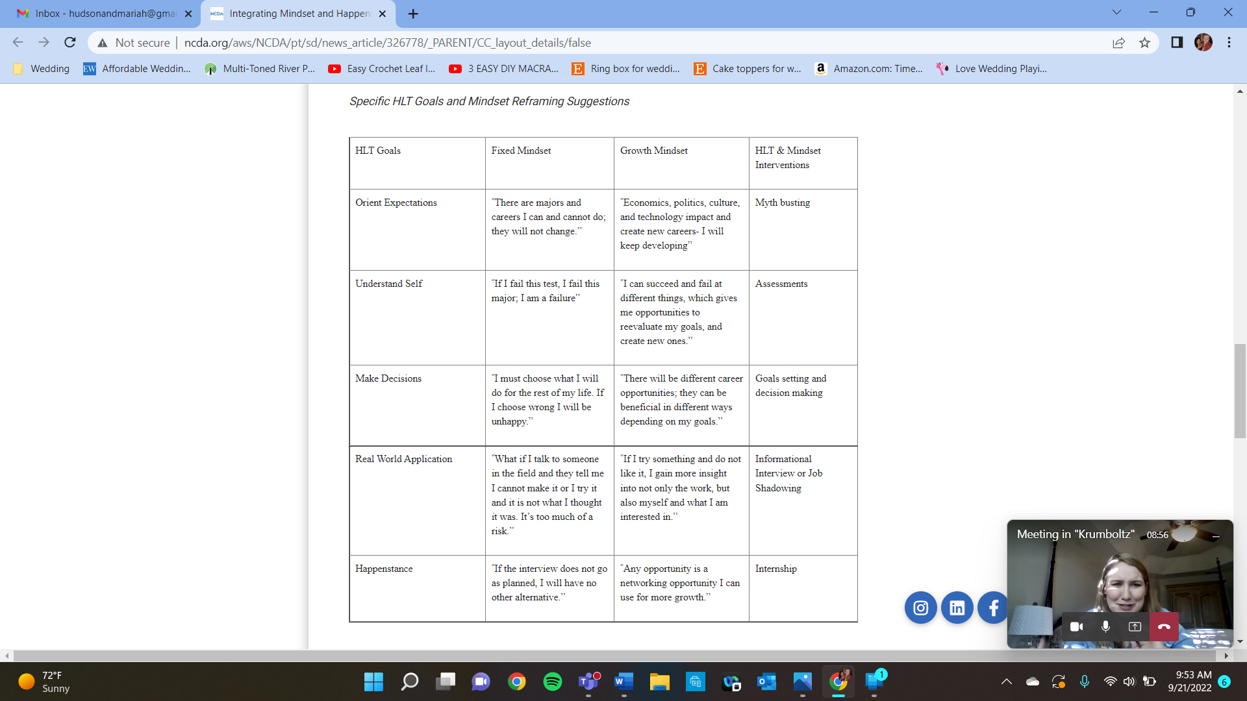
How would this look in counseling??
Marshall & Bennett, 2020
Notes:
Erica presents

Slide 16
Multicultural and Social Justice
Counselor
Client
Environment, Experiences Values, Advantages/Disadvantages, Barriers, Perspectives, and Biases
Sensitivity for the Individual Experience
Notes:
Erica presents Sensitivity for the Individual Experience ​
Awareness
of our own and our Clients’
Environment, Values, Advantages/Disadvantages, Barriers, Perspectives, and

Slide 17

Multicultural and Social Justice Resources
Integrating Mindset and Happenstance Learning Theory
  https://www.ncda.org/aws/NCDA/pt/sd/news_article/326778/_PARENT/CC_layout_details/false
Developing a Growth Mindset
  https://youtu.be/hiiEeMN7vbQ
Power of Yet
  https://youtu.be/J-swZaKN2Ic
Notes:
Mariah presents

Slide 18
References
Krumboltz, J. D. (1998). Serendipity is not serendipitous. Journal of Counseling Psychology, 45, 390–392. http://doi,org/10.1037/0022-0167.45.4.390
Krumboltz, J. D., & Worthington, R. L. (1999). The school‐to‐work transition from a learning theory perspective. The Career Development Quarterly, 47(4), 312-325. https://doi.org/10.1002/j.2161-0045.1999.tb00740.x
Krumboltz, J. D. (2009). The Happenstance Learning Theory. Journal of Career Assessment, 17(2), 135–154. https://doi.org/10.1177/1069072708328861
Krumboltz, J. D. (2015). Practical career counseling applications of the happenstance learning theory. In P. J. Hartung, M. L. Savickas, & W. B. Walsh (Eds.), APA handbook of career intervention, Volume 2: Applications. (pp. 283–292). American Psychological Association. https://doi.org/10.1037/14439-021
Krumboltz, J. D., Mitchell, A. M., & Jones, G. B. (1976). A social learning theory of career selection. The Counseling Psychologist, 6(1), 71-81. https://doi.org/10.1177/001100007600600117
LaFromboise, T., Williams, E. N., & Jackson, M. A. (2019). John D. Krumboltz (1928–2019). The Counseling Psychologist, 47(8), 1165-1167. https://doi.org/10.1177/0011000019894696
Marshall & Bennett. (2020, October 01).Integrating mindset and Happenstance Learning Theory in a post-secondary setting. National Career Development Association. https://www.ncda.org/aws/NCDA/pt/sd/news_article/326778/_PARENT/CC_layout_details/false
McMahon, M., & Arthur, N. (2018). Career development theory. Contemporary Theories of Career Development, 3-19. https://doi.org/10.4324/9781315276175-2
Notes:
Mariah…ask for questions

