Slide 1
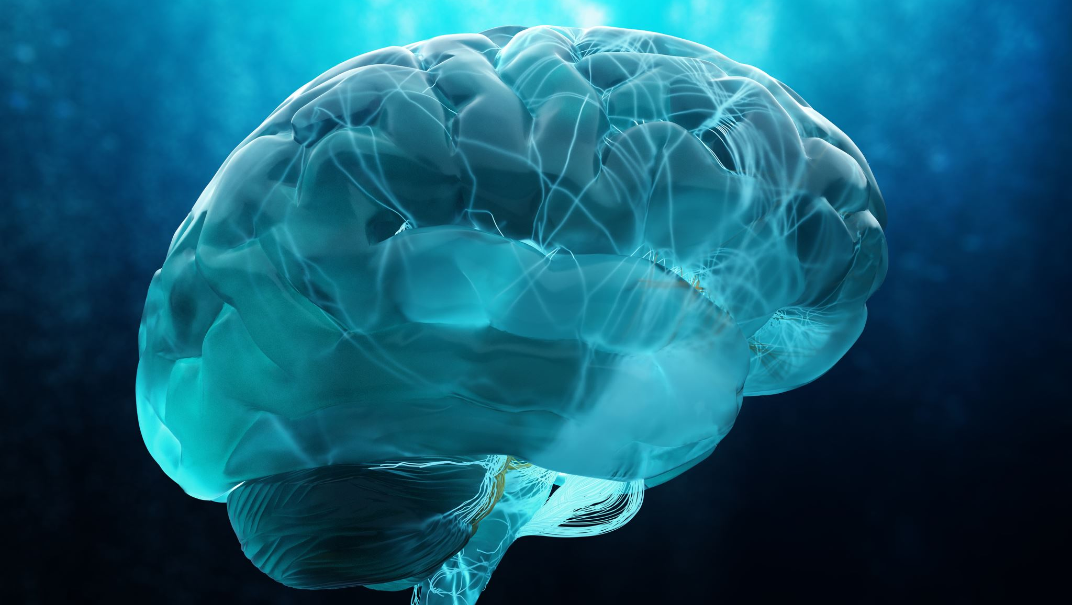
NURTURING THE MIND FOR OPTIMAL BRAIN HEALTH
EXPLORING
THE HEALTHY MIND PLATTER
Erica Rhoads, Ph.D. LPC, NCC
Deanna Bishop, MS, LMHC-S, LPC
Ana Barend, MA, LMHC, NCC
Notes:
Erica Introduce the team

Slide 2
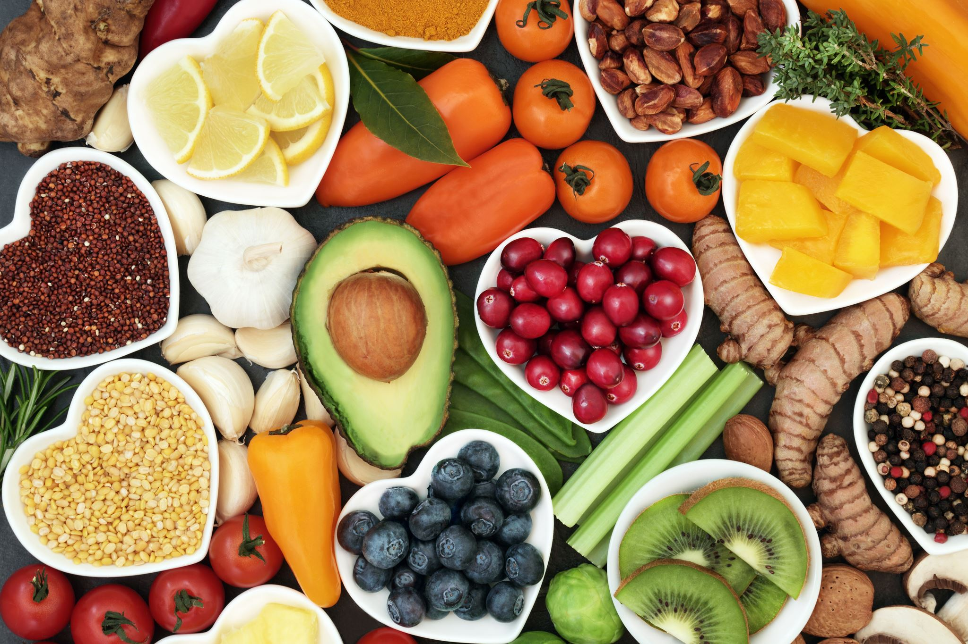
HEALTHY
MIND PLATTER
Notes:
ANA Burn-out and decreased mental health are increasing in our society. Calls for increasing mental health literacy are gaining attention. Carvalho's team described a need for greater positive mental health literacy. The Healthy Mind Platter is one option to help increase understanding of improving our mental well-being with a healthy mind. These suggestions counter the unhealthy brain that is not integrated or differentiated properly.
DEFINE MIND
Embodied and relational process that regulates flow of energy and information

Slide 3
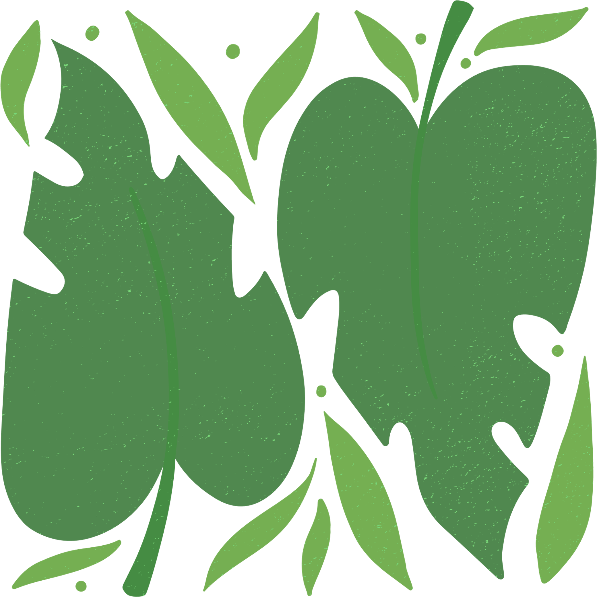
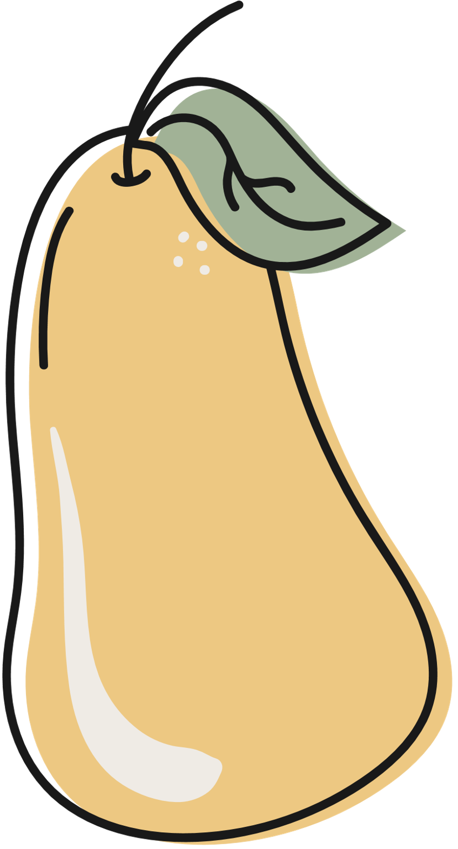
Objectives:
Identify
Practice
Develop
the seven activities and the underlying neuroscience that nurture the mind for optimal brain health
a self-assessment of the mind platter "diet"​
a plan to create a healthy mind platter for personal use and ways to share with students and clients
Notes:
Deanna

Slide 4

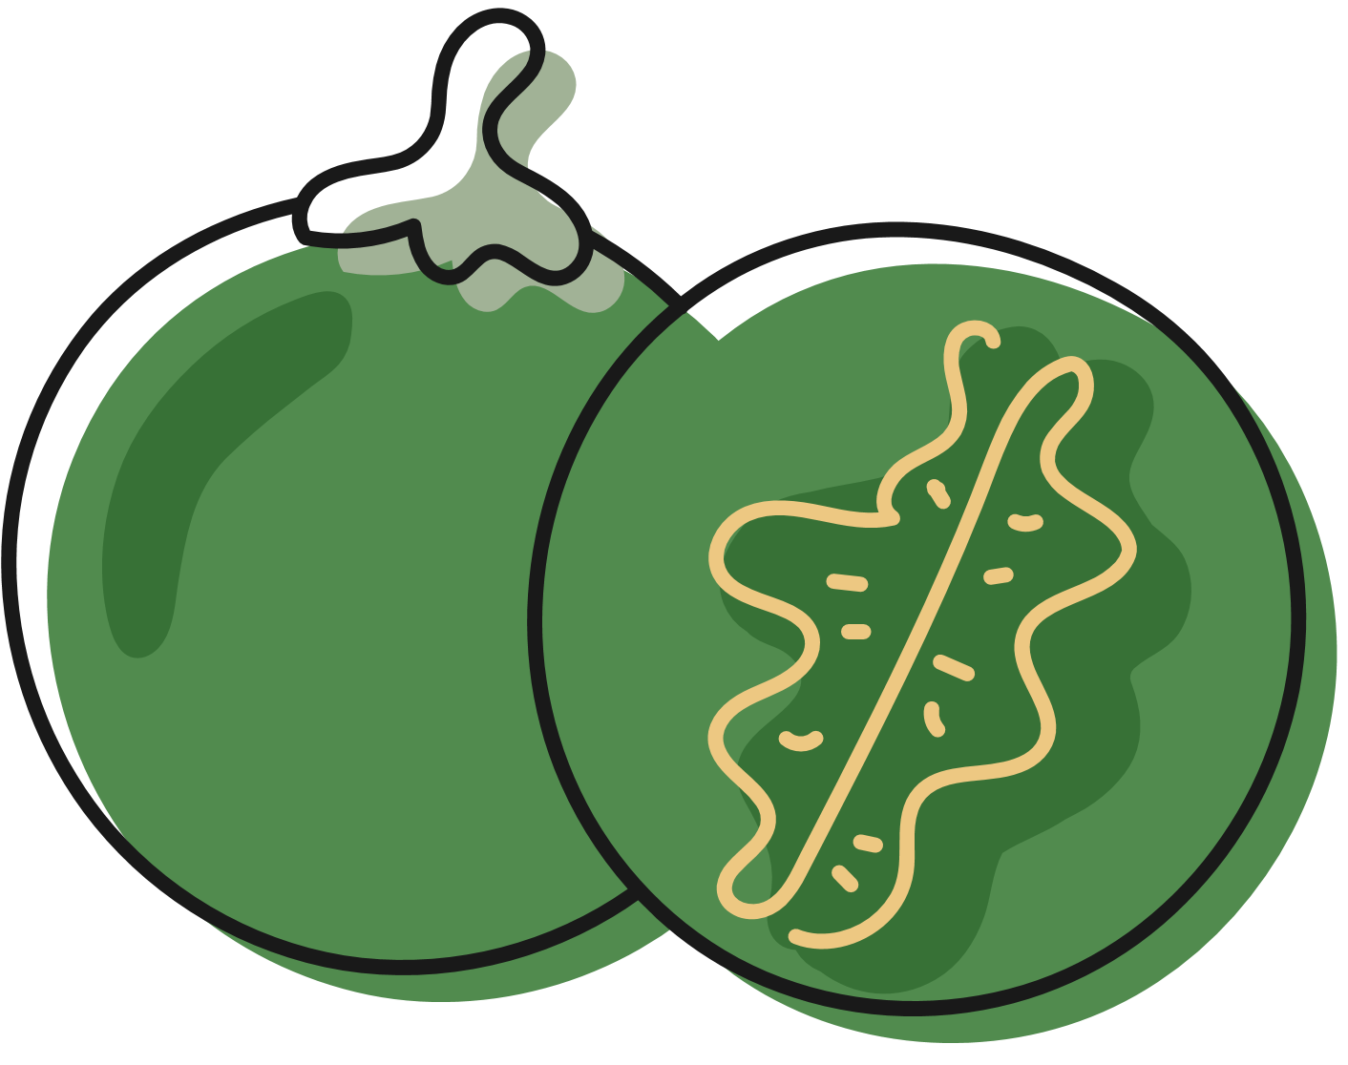

THE SEVEN ESSENTIAL ACTIVITIES
FOCUS
PLAY
CONNECTING
PHYSICAL
TIME IN
DOWN TIME
SLEEP TIME
Rock, et al., 2012
Notes:
Erica – Name 7 Activities

Slide 5


FOCUS TIME: ACTIVITIES THAT REQUIRE CONCENTRATION AND FOCUS, STRENGTHENING NEURAL CONNECTIONS.
Notes:
Deanna

Slide 6
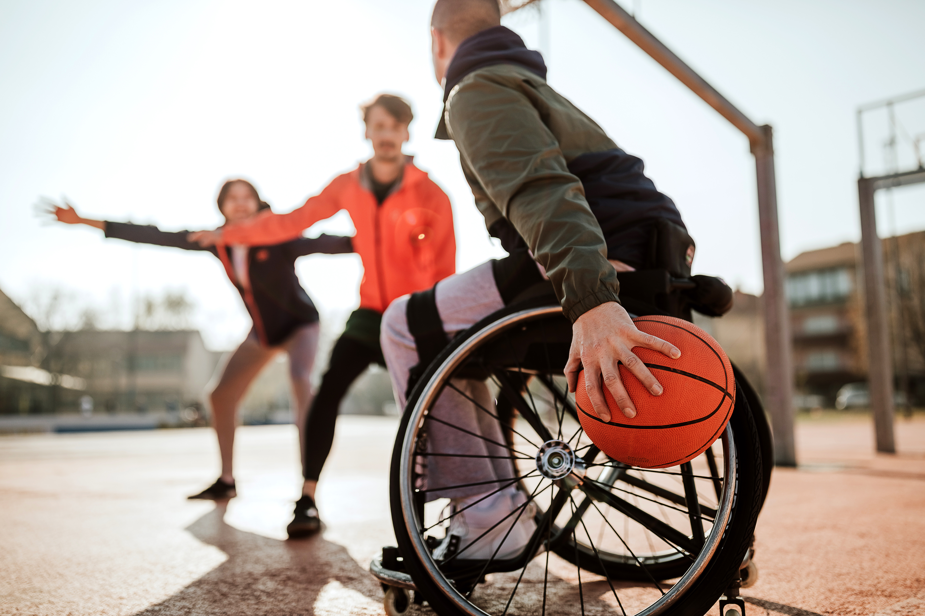

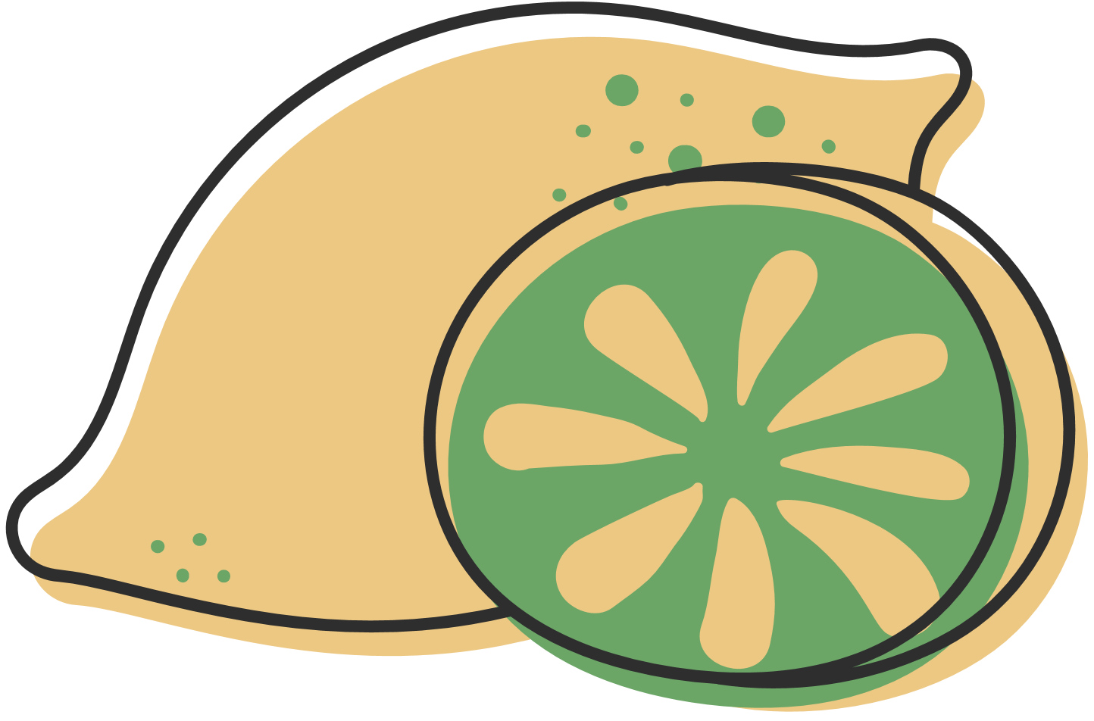
PLAY TIME
ENGAGING IN FUN AND CREATIVE ACTIVITIES THAT PROMOTE NOVELTY AND ADAPTABILITY.
Notes:
Erica – We know the benefits for children as the learn and heal through play...follow their example! Think of play as an opportunity to learn adaptive social behavior...dad jokes, laughing with a group of friends...

Slide 7

CONNECTING TIME: INTERACTING WITH OTHERS, FOSTERING SOCIAL RELATIONSHIPS, AND EMPATHY.
Notes:
Deanna

Slide 8
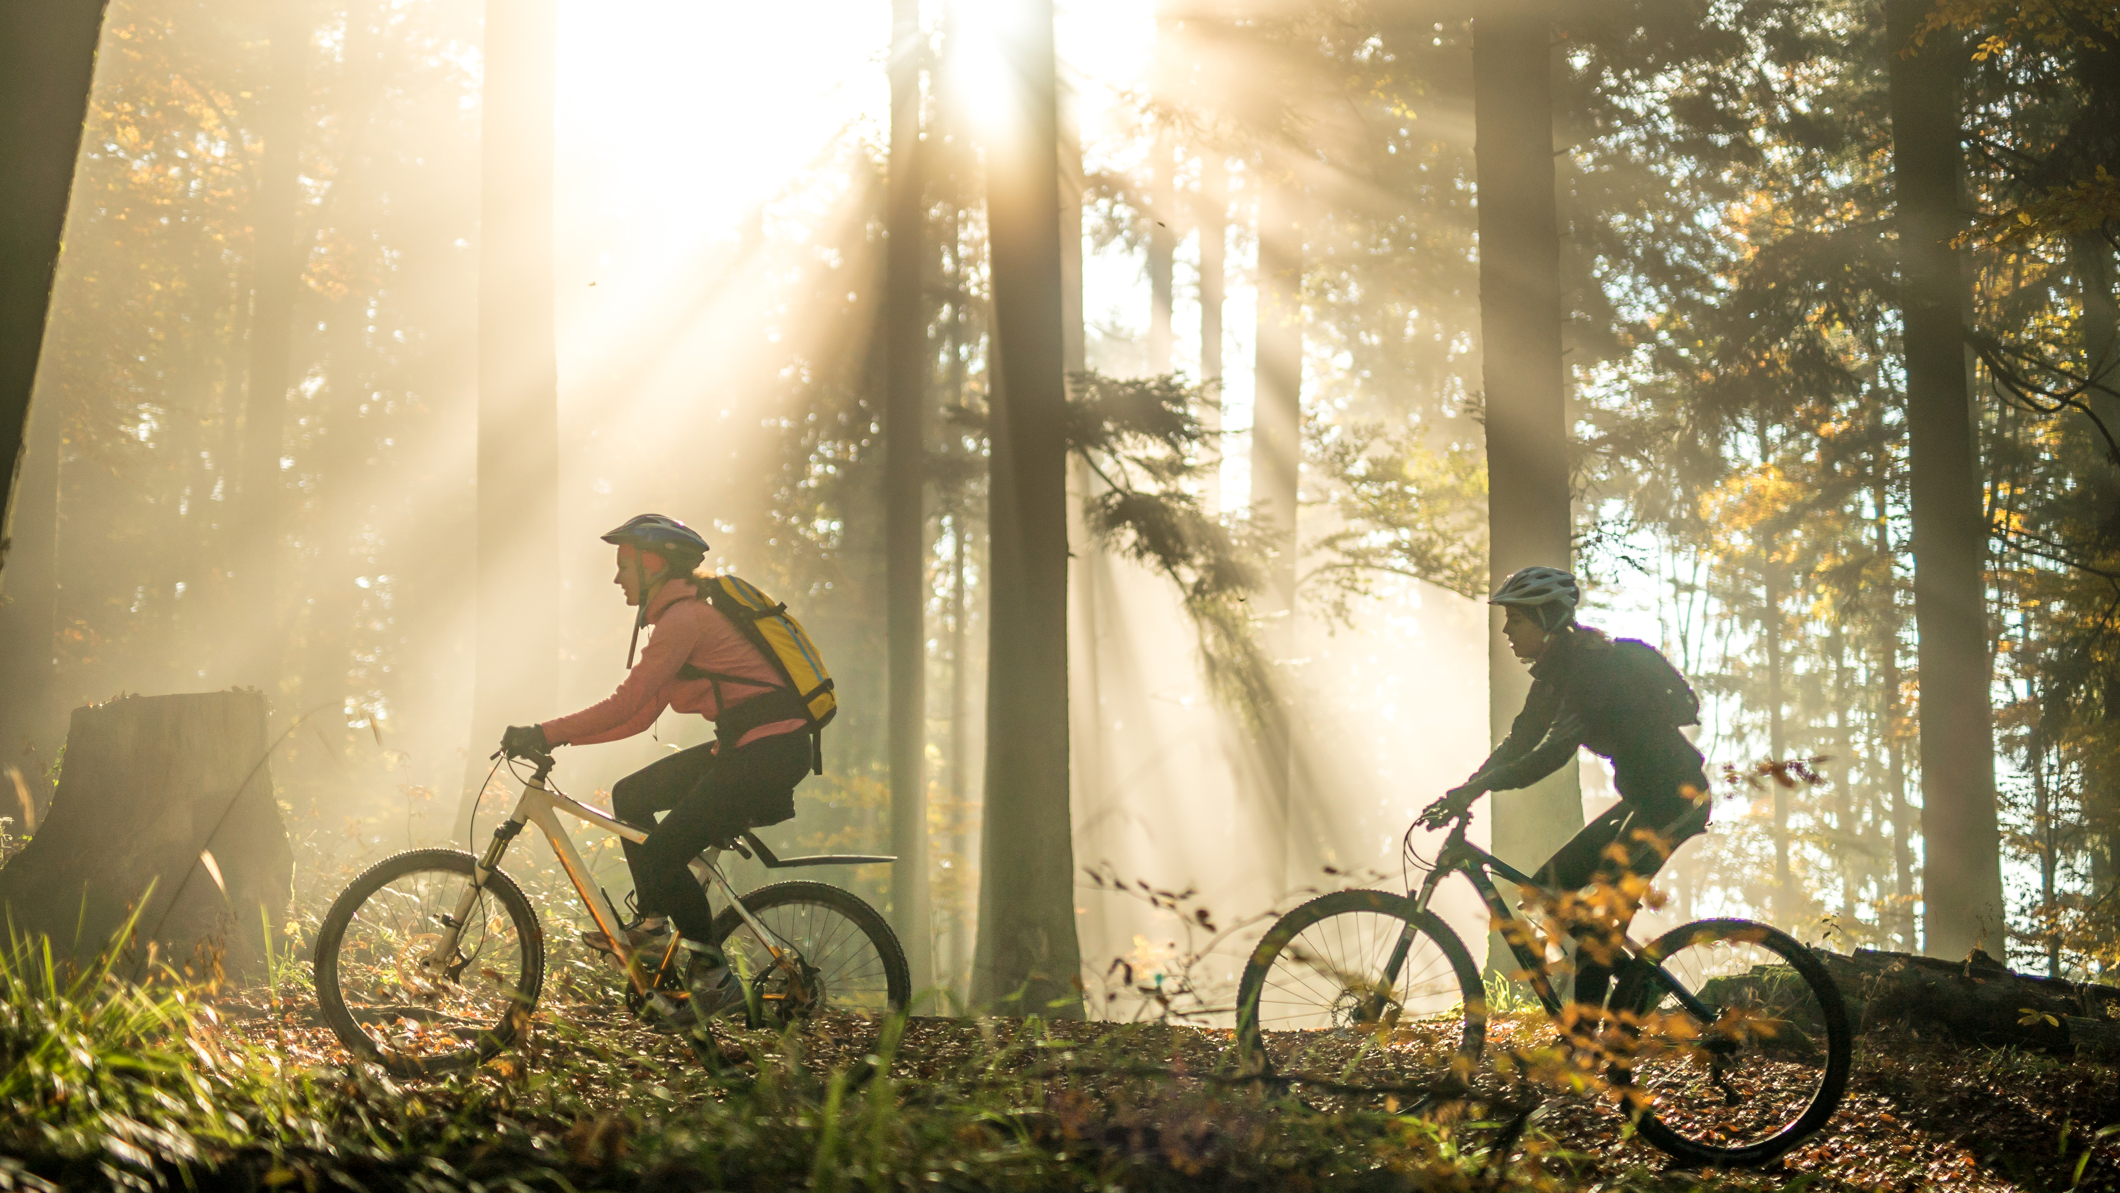
PHYSICAL TIME: PHYSICAL EXERCISE THAT BOOSTS BRAIN FUNCTION AND OVERALL WELL-BEING.
Notes:
Erica – regular exercise activates molecular and cellular cascades that support and maintain brain plasticity. Think about how taking a walk gets your heart pumping and moving blood not just through your body, but to your brain as well.

Slide 9

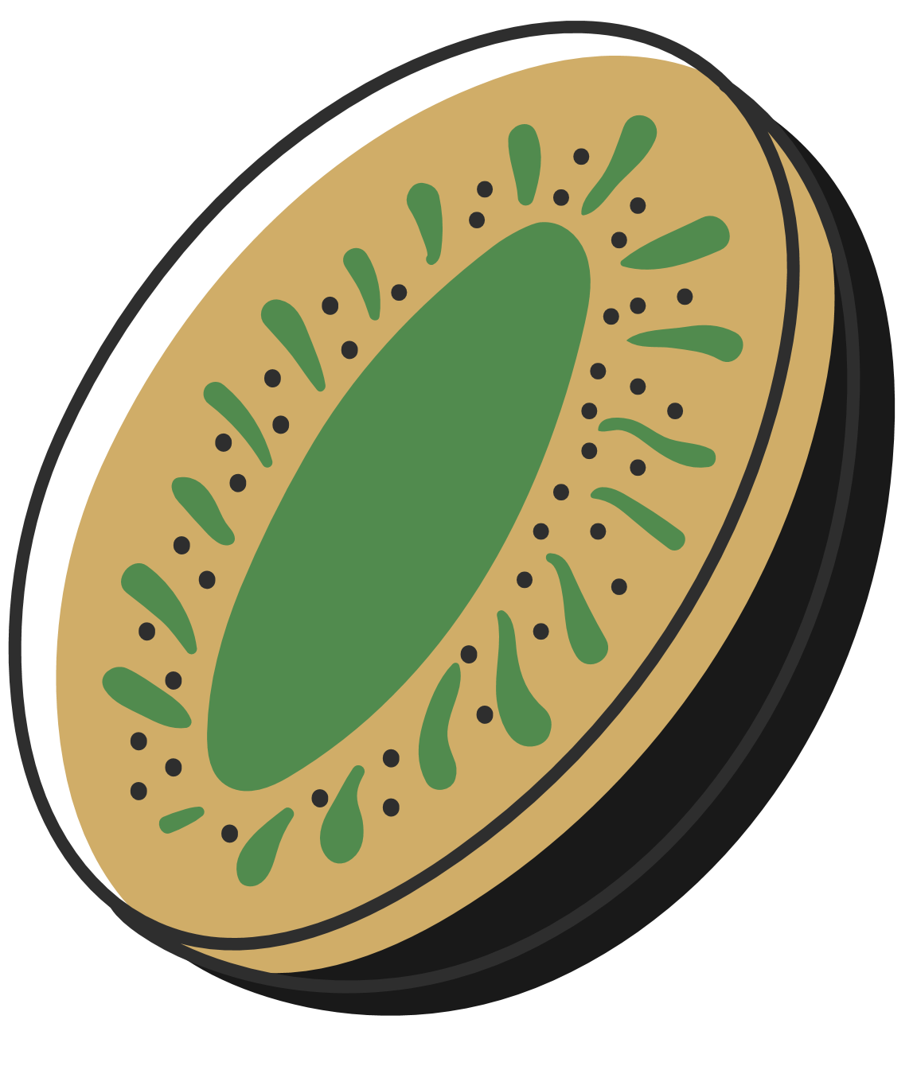
TIME IN
REFLECTION, MINDFULNESS, AND SELF-AWARENESS PRACTICES
Notes:
Ana
Decrease in sympathetic activation: decreased heart rate and muscle tension

Slide 10

DOWN TIME: RELAXATION AND LEISURE ACTIVITIES THAT PROVIDE REST AND RECOVERY.
  Disconnecting
  Spacing out
  Wasting time
Notes:
Erica: Have you ever tried to think of something that was on the tip of your tongue and it just wouldn't come to you? Then later when you are on a totally different train of thought, it pops into your head!
This is the key to harnessing our unconscious problem-solving. Down time is giving your brain a break from intentional linear focus and going "offline" to allow our brain to sort out thoughts, and provide integration by linking differentiated parts.
Taking a break from a demanding task with some downtime, will nearly always provide better results upon return.

Slide 11


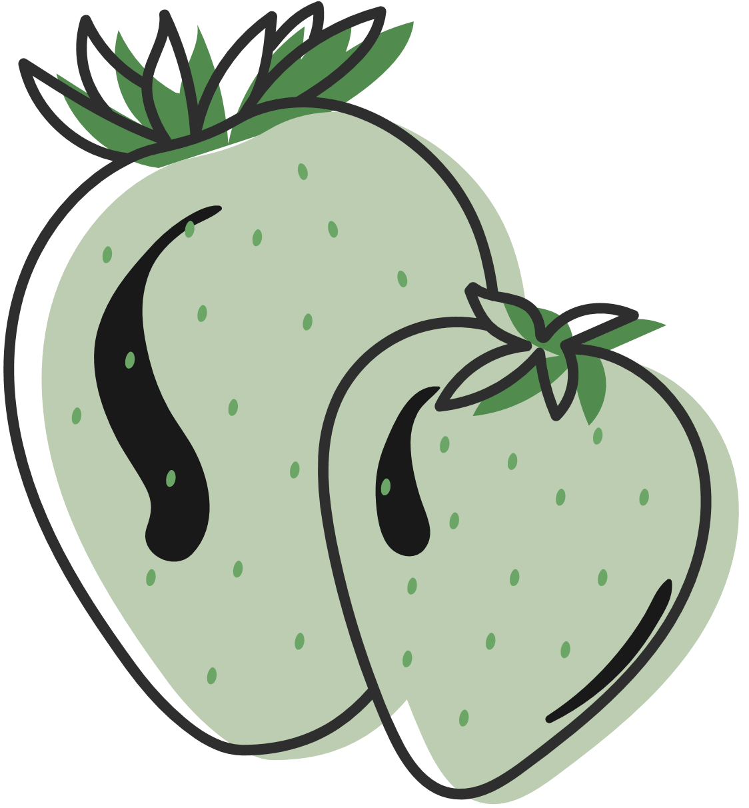
SLEEP TIME​
​
QUALITY SLEEP THAT CONSOLIDATES LEARNING AND REJUVENATES THE BRAIN​
​
Notes:
ANA
Sleep deprivation can be more lethal than food deprivation. Drowsy drivers are responsible 20% of accidents.
Lack of sleep is linked w/ depression
Important for the body, critical for the brain.
REM– insight, creativity, problem solving

Slide 12
SELF-ASSESSMENT OF YOUR MIND PLATTER
  Reflect on your daily activities and how they align with the seven essential activities.
  Self-Assessment Questions:
  - How much time do you spend on each of the seven activities?
  - Which activities do you prioritize, and which do you neglect?
  - How balanced is your daily routine in terms of these activities?
Notes:
ANA Next we are going to give you the opportunity to learn more about each area and you can reflect on your current level and what (if any) changes you want to make.

Slide 13

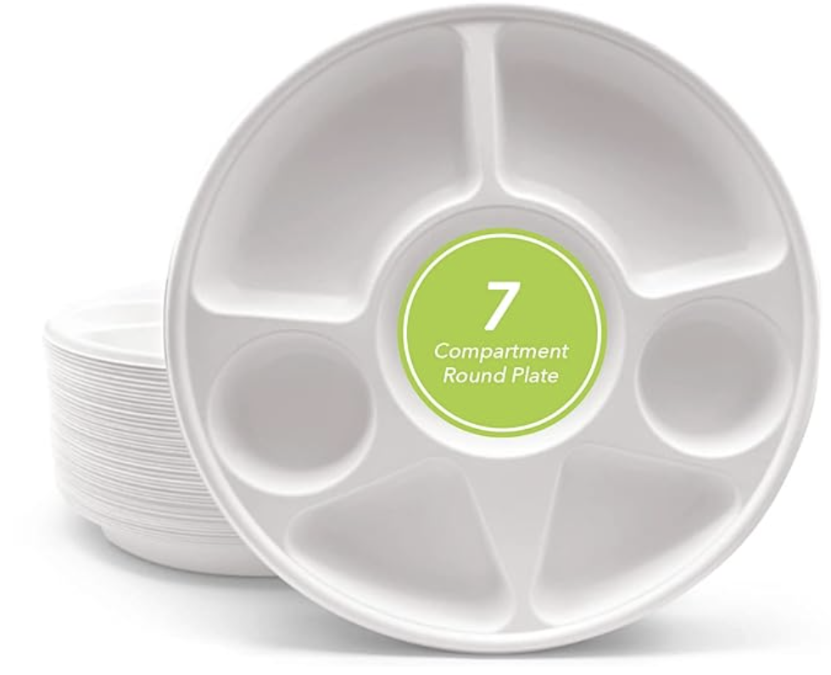
As we go more in-depth... ​
​
​
Ponder on your diet!​
Notes:
Deanna- Give instructions
Erica- Hand out plates.

Slide 14
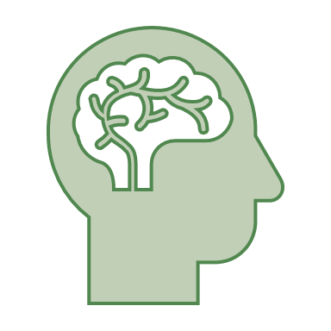
FOCUS TIME
  Engaging in activities that require undivided attention and concentration.
  Benefits: Strengthens neural pathways, improves cognitive function, and enhances productivity.
  Examples: Studying, working on a challenging project, solving problems.
Notes:
Deanna

Slide 15
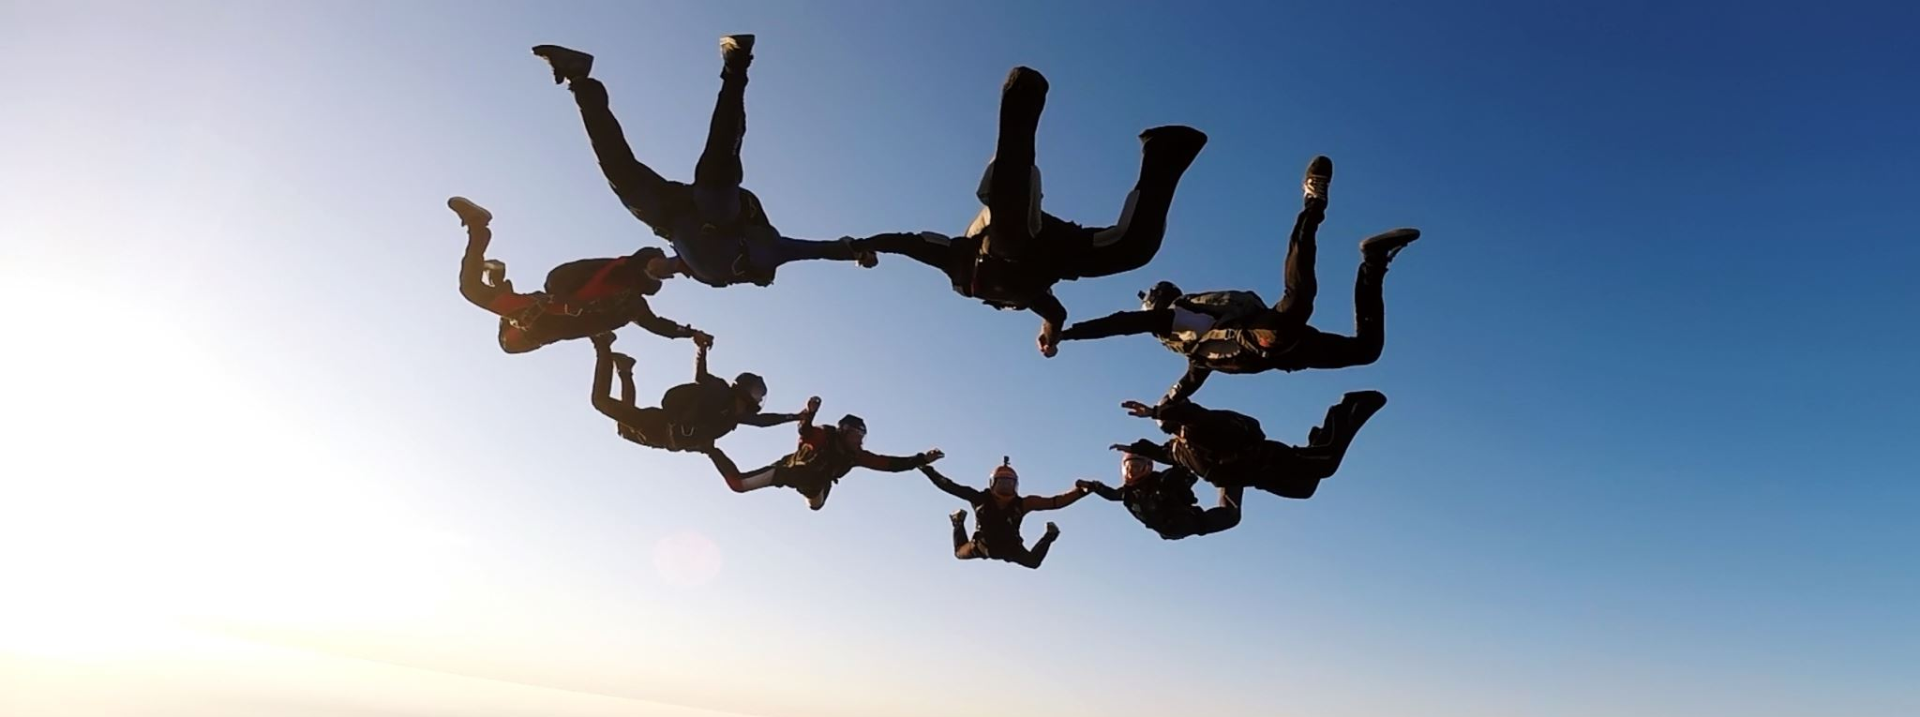
  Participating in fun, spontaneous, and creative activities.
  Benefits: Promotes brain plasticity, enhances creativity, and reduces stress.
  Examples: Playing games, engaging in hobbies, exploring new interests.
PLAY TIME
Notes:
Erica Rhoads – increases innovation, adaptability, increases creativity. Activates the Play-Joy network in the brain...
Possible antidote for ADHD in kids as play impacts frontal lobe maturation.
Scary Statistics: 90% of 26 murderers studied by Stuart Brown had history of play deprivation or abnormal play.

Slide 16
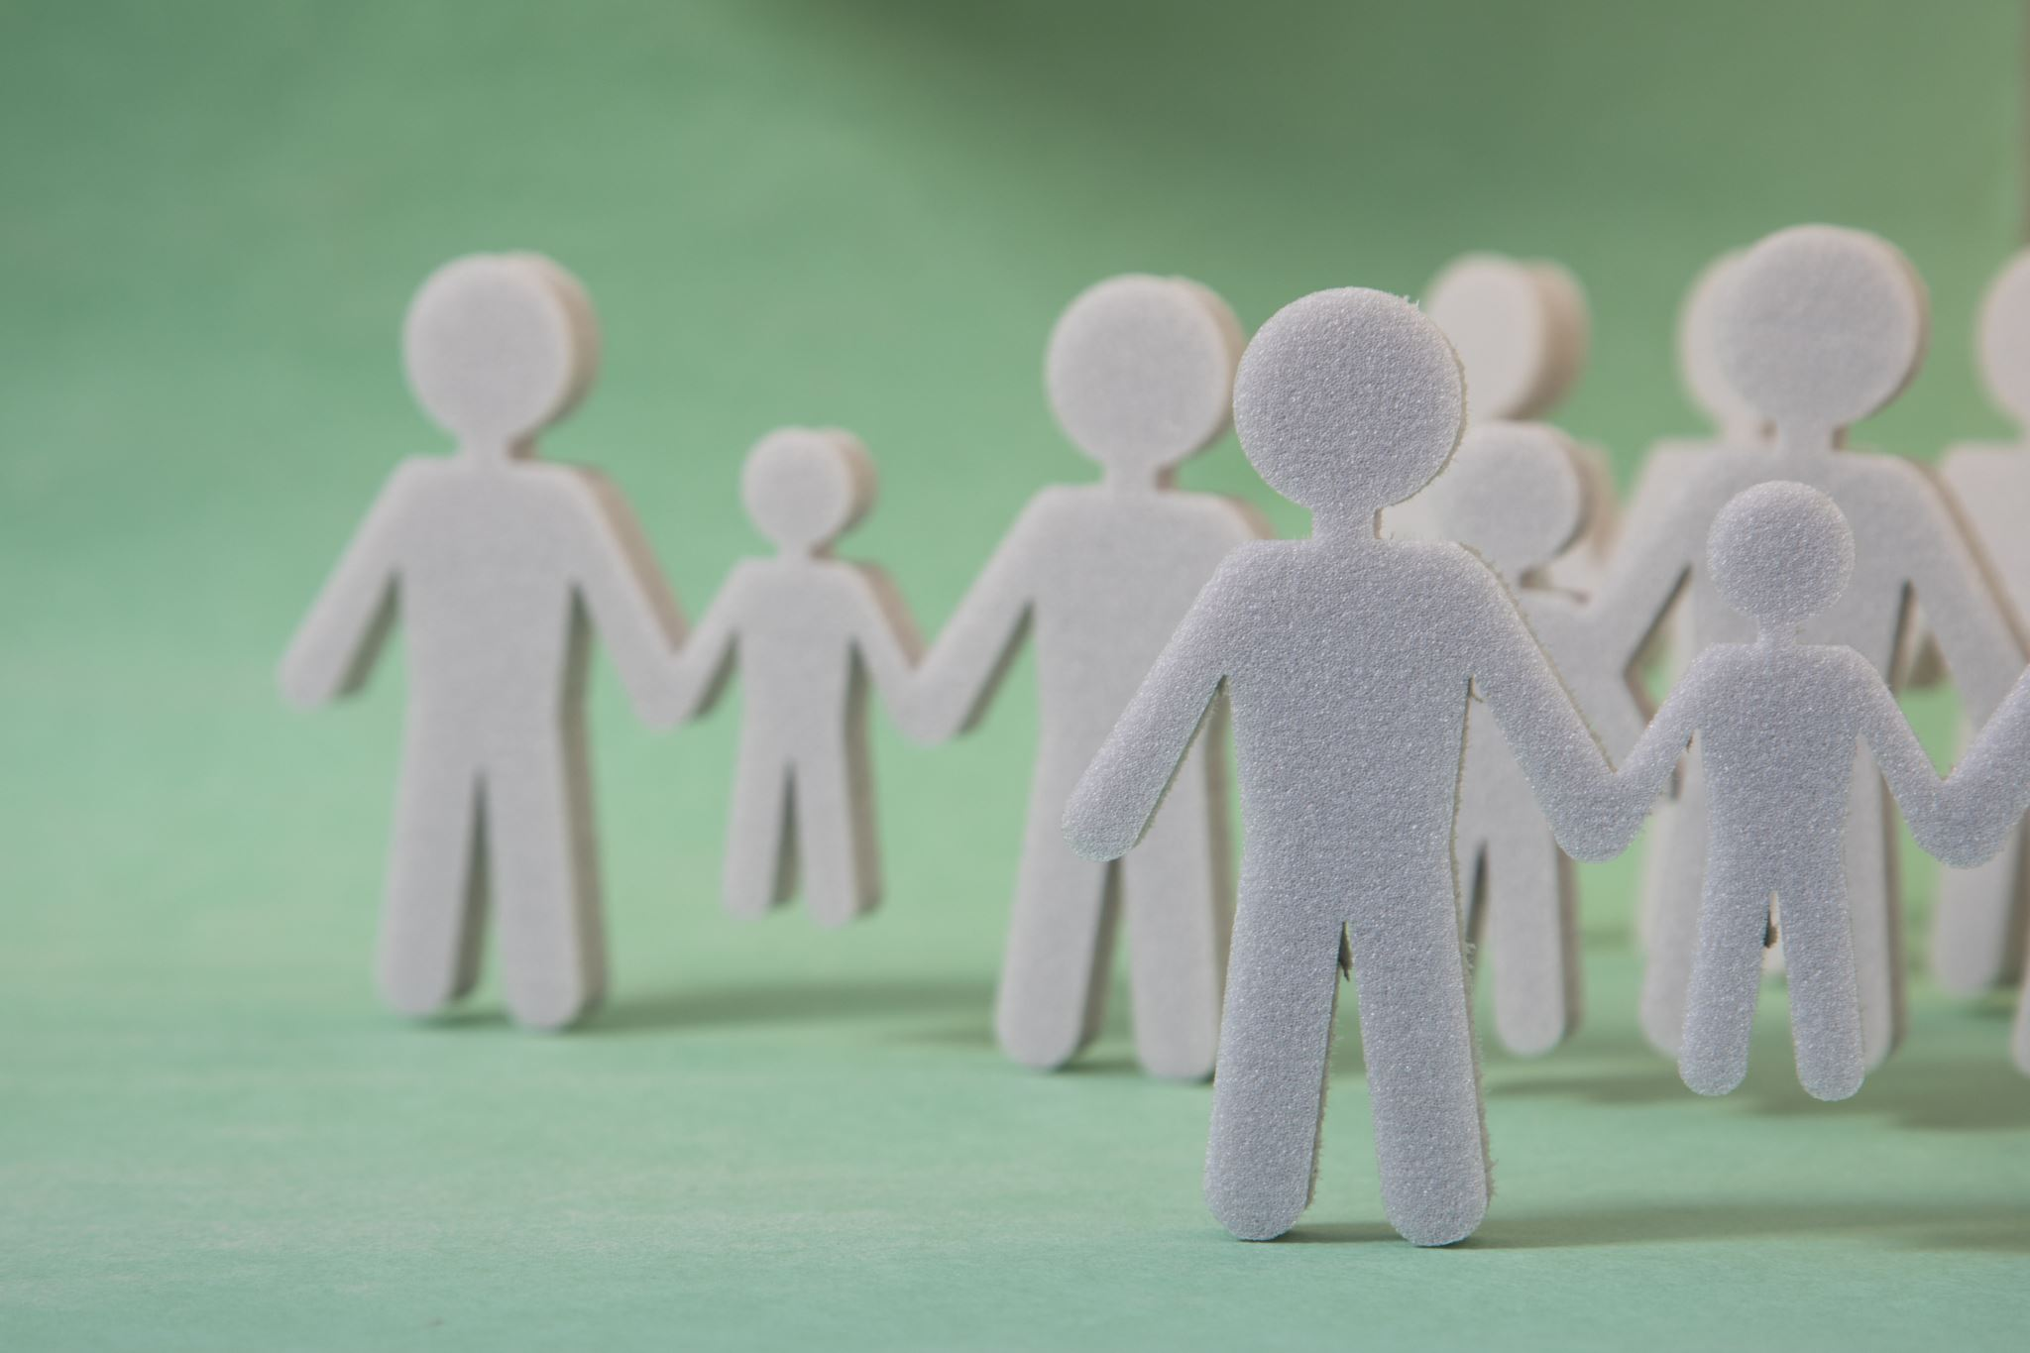
CONNECTING TIME
  Spending time with family, friends, and social networks.
  Benefits: Boosts emotional well-being, fosters empathy, and strengthens social bonds.
  Examples: Social gatherings, conversations, collaborative activities.
Notes:
Deanna Bishop
Erica – Prep Menti activity

Slide 17
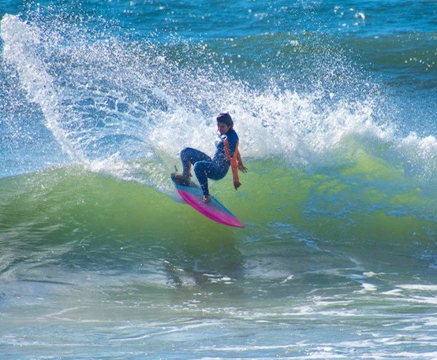
PHYSICAL TIME
  ENGAGING IN PHYSICAL EXERCISE AND ACTIVITIES.
  BENEFITS: ENHANCES PHYSICAL HEALTH, BOOSTS MOOD, AND IMPROVES COGNITIVE FUNCTION.
  EXAMPLES: WALKING, RUNNING, YOGA, SPORTS.
Notes:
Erica Rhoads – think about the "runner's high" flooding the body with feel good hormones – impact on the brain.
Any suggestions of physical activities that help you feel better? Audience answer?

Slide 18
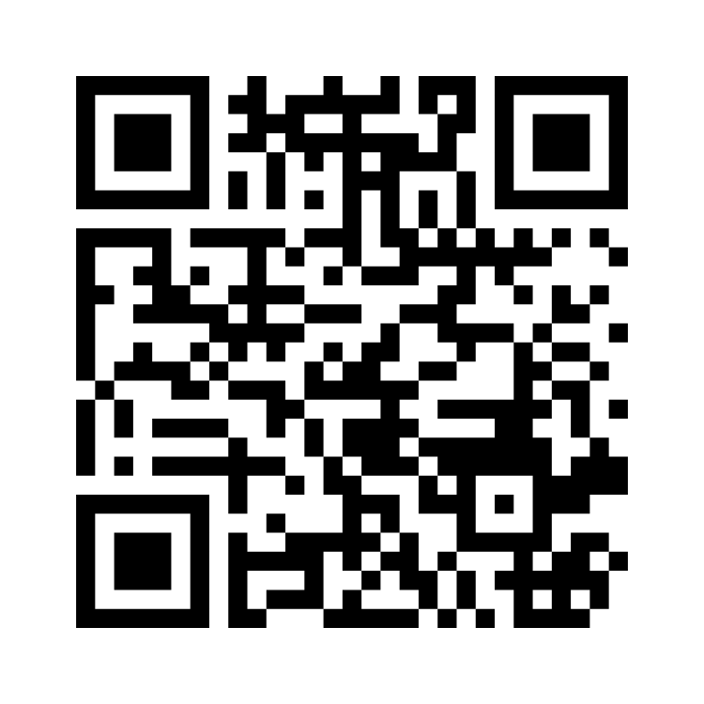
What Physical Activities makes you feel good?
Use QR code to enter your ideas
Notes:
Share word cloud screen

Slide 19

TIME IN
  Practices that promote self-reflection, mindfulness, and inner awareness.
  Benefits: Reduces stress, enhances self-awareness, and improves emotional regulation, increase in positive affective state.
  Examples: Meditation, journaling, praying, deep breathing exercises.
Notes:
ANA Importance of regular practice! Research has shown that small regular practice is more effective than an hour practice, but w/ less consistency.
More examples?
Walking in nature
Listening to music
MORE THAN RELAXATION:
Intention, attention,
Awareness of awareness
Mindfulness: present moment awareness, curiosity, non judgmental stance, openness, acceptance of process rather than content.
Let’s practice....

Slide 20

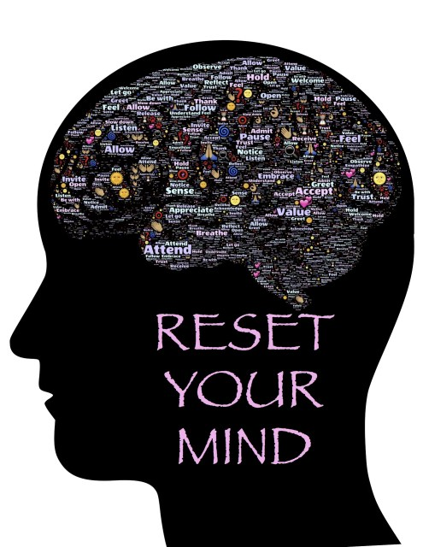
DOWN TIME
  ACTIVITIES THAT ALLOW THE MIND TO RELAX AND UNWIND.
  BENEFITS: PROVIDES MENTAL REST, REDUCES STRESS, AND FOSTERS CREATIVITY.
  EXAMPLES: WATCHING TV, LISTENING TO MUSIC, TAKING A NAP.
ThePhoto by PhotoAuthor is licensed under CCYYSA.
Norcross & VandenBos, 2018
Notes:
Erica Rhoads
Putting your mind in a positive mood enhances the ability to return to solve problems. You are giving your left brain a break and opening up your right brain to its creativity, thinking outside the box for open-minded ideas.
discuss healthy escapes such as taking a mini-break by walking away from your desk or office, laughing: connecting with your sense of humor, coloring in an adult coloring book, taking a few minutes (or longer) lingering in nature...Not so healthy ways: self-blame or substance use.

Slide 21

SLEEP TIME
  ENSURING SUFFICIENT AND QUALITY SLEEP.
  BENEFITS: CONSOLIDATES LEARNING, MEMORY CONSOLIDATION, REJUVENATES THE BRAIN, EMOTIONAL PROCESSING AND PROMOTES OVERALL HEALTH.
  EXAMPLES: ESTABLISHING A SLEEP ROUTINE, CREATING A RESTFUL ENVIRONMENT, SAME TIME DAILY.
Notes:
ANA: More benefits:
Tissue repair, homeostatic restoration, immunity, memory processing, emotional regulation, integrates learning into long term knowledge.
Sleep on it....
7-9 hours
Sleep hygiene

Slide 22
CREATING YOUR HEALTHY MIND PLATTER
Steps to Develop a Plan:
Set specific, achievable goals to incorporate more of each activity
Create a weekly schedule that includes a balance of the seven activities
Assess what is working and what needs adjusted for the season of life
Determine what is working and what needs changed
Notes:
Deanna
Example Plan: Provide a sample weekly plan that incorporates all seven activities.
Tips: Offer practical tips for integrating these activities into a busy lifestyle.

Slide 23

PROMOTING THE HEALTHY MIND PLATTER
  Strategies for Educators, Supervisors, and Counselors:
  Incorporate the concepts into lesson plans and therapy sessions.
  Provide resources and tools for individuals to track their progress.
  Benefits: Highlight the benefits of a balanced mind platter for mental health and well-being.
https://drmarkmcgrath.com.au/2018/09/15/healthy-mind-platter/
https://www.fettle.ie/blog/the-healthy-mind-platter
Notes:
ANA Case Study: Ana’s Client (time permitting)

Slide 24
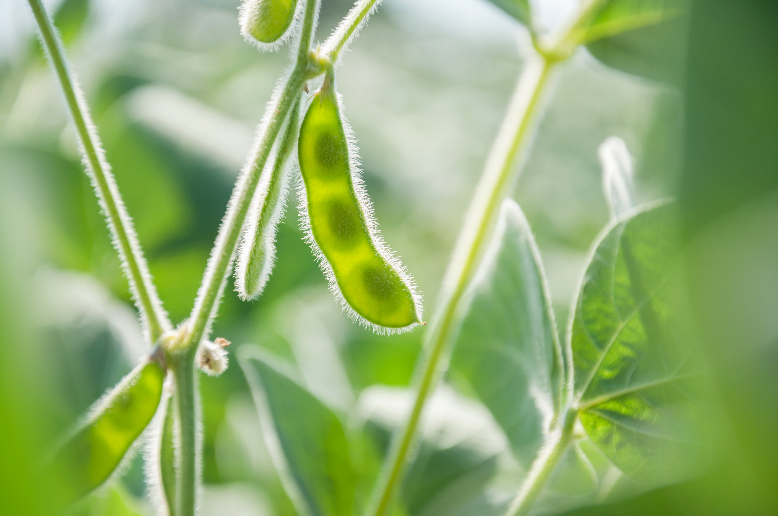
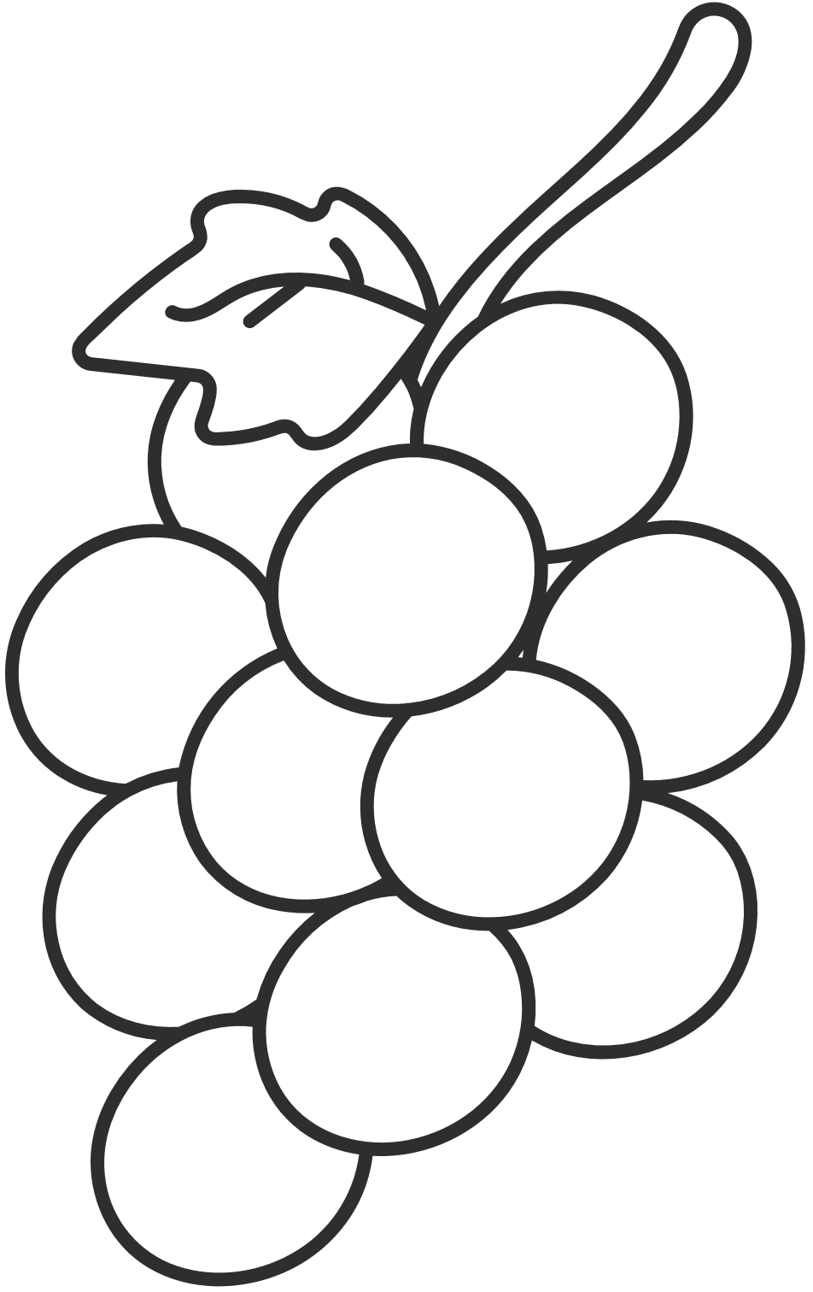
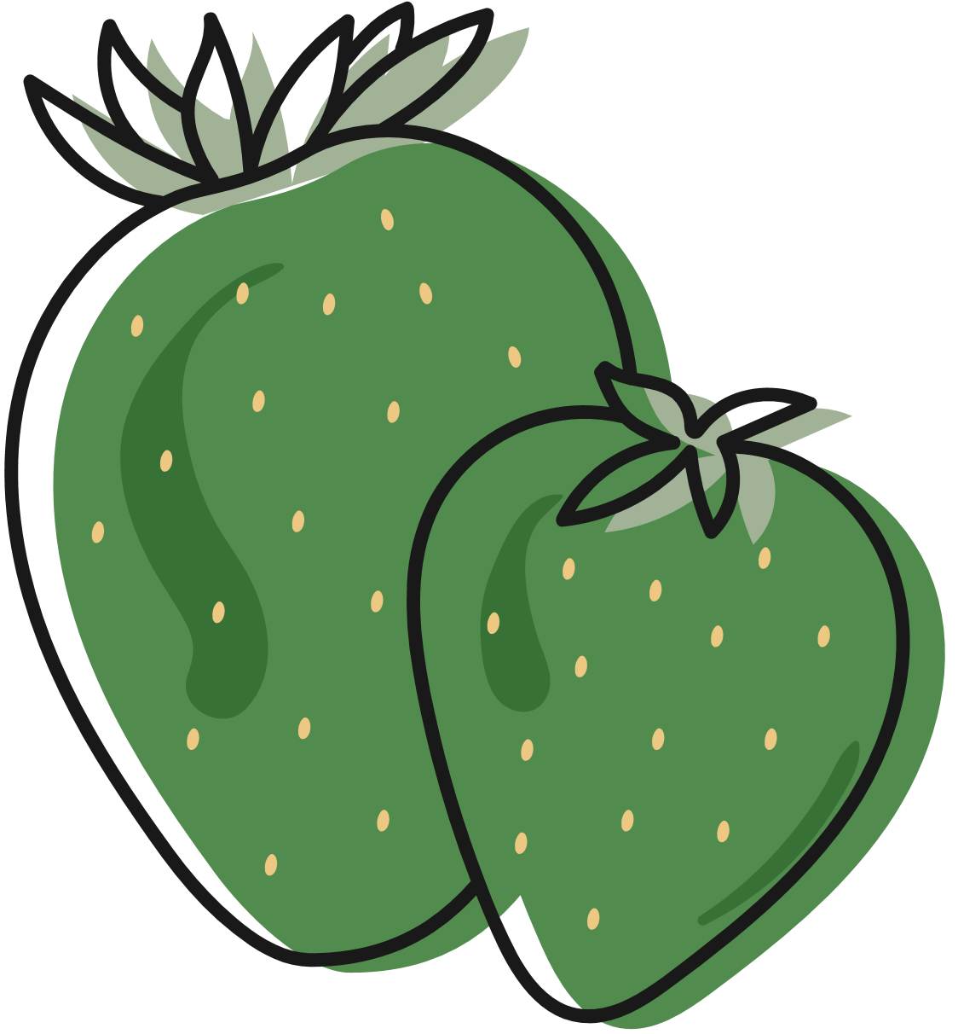
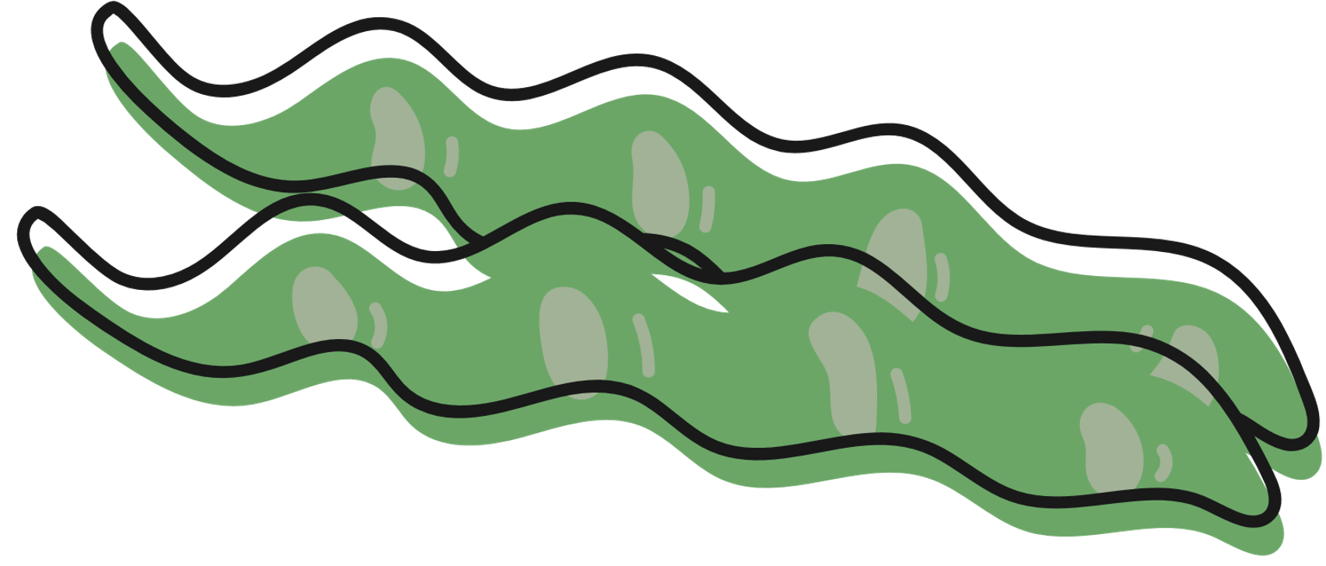
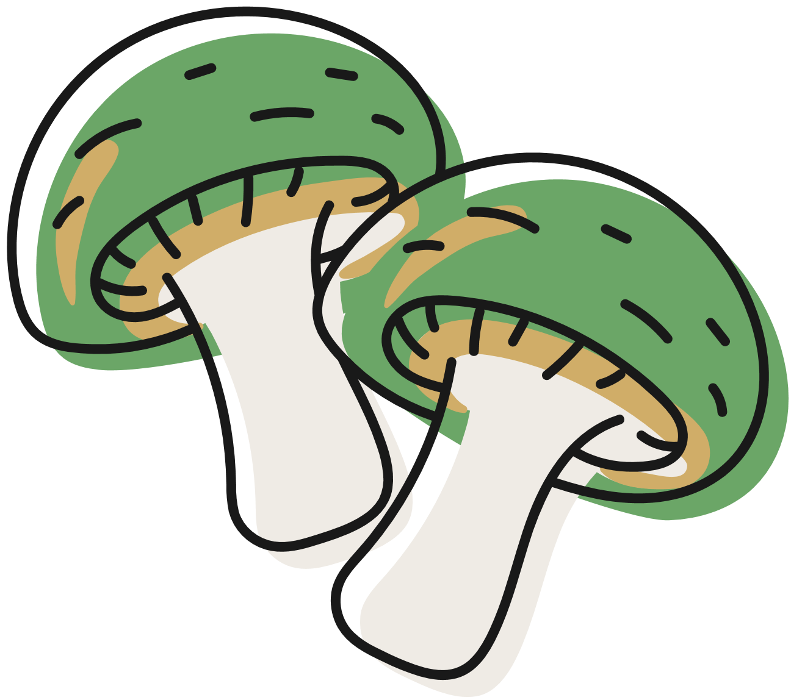
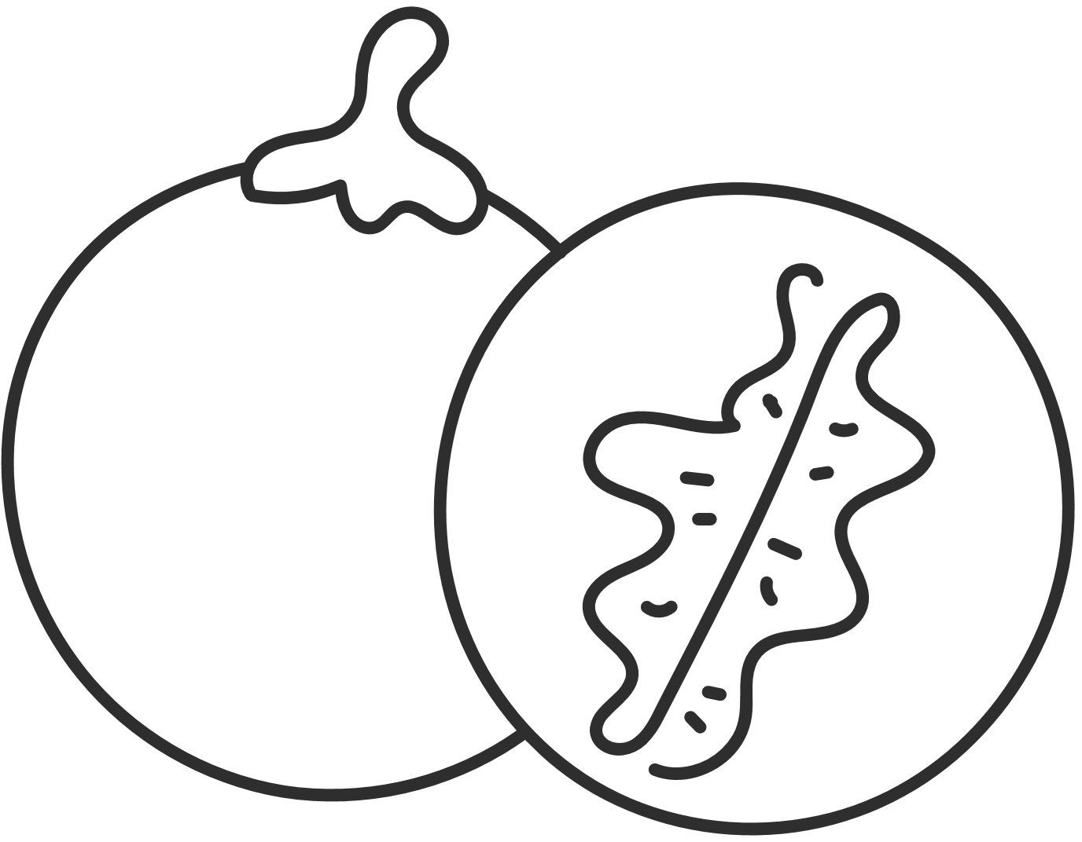
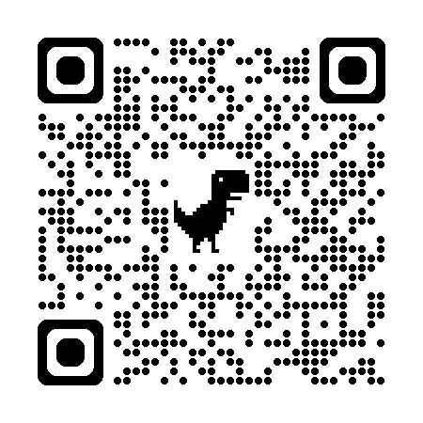
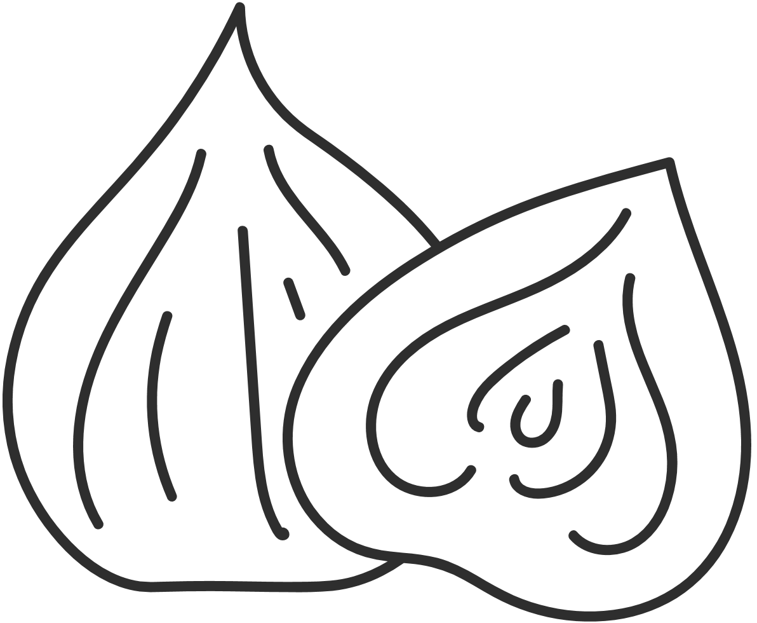
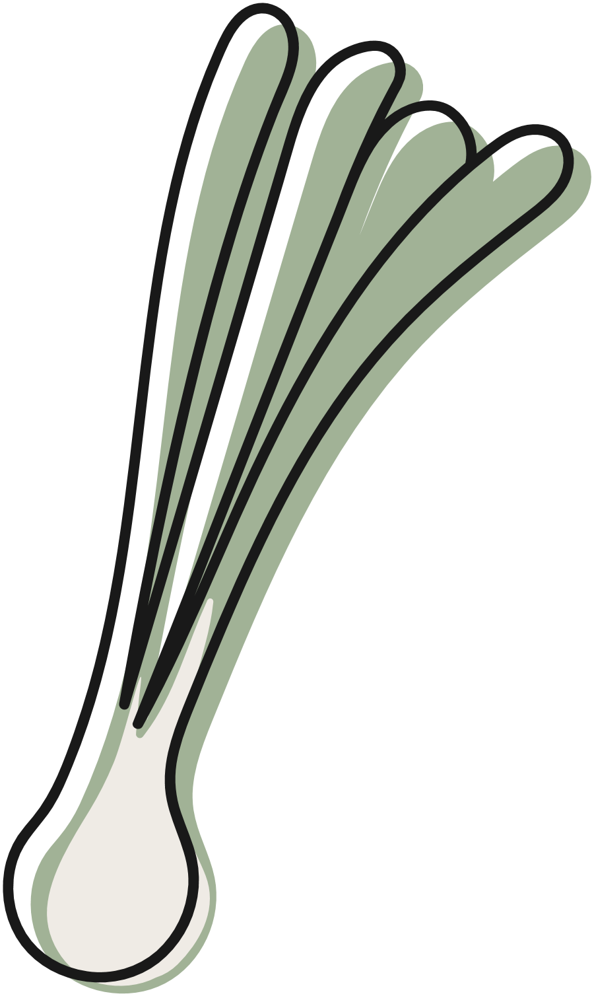
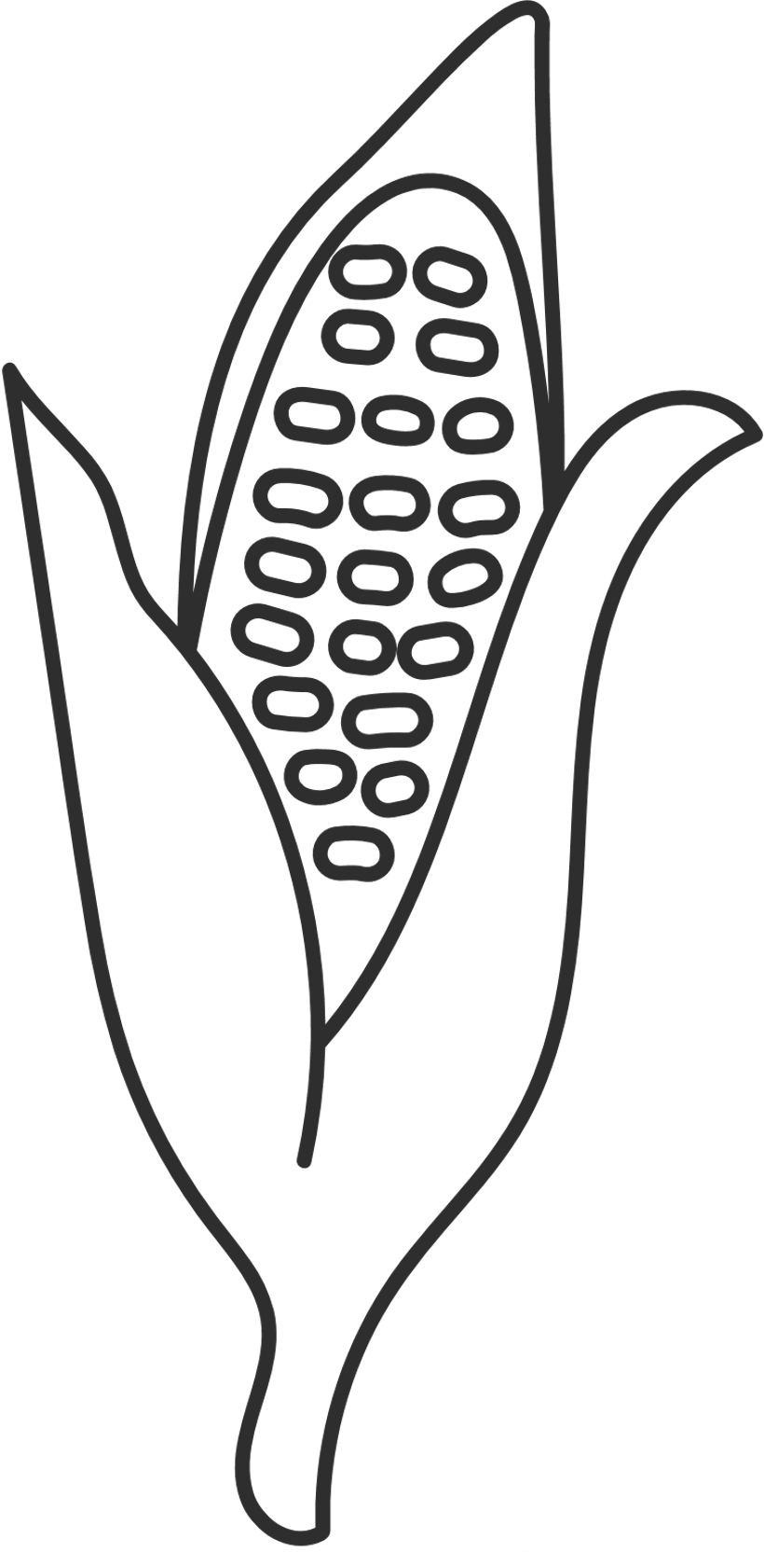
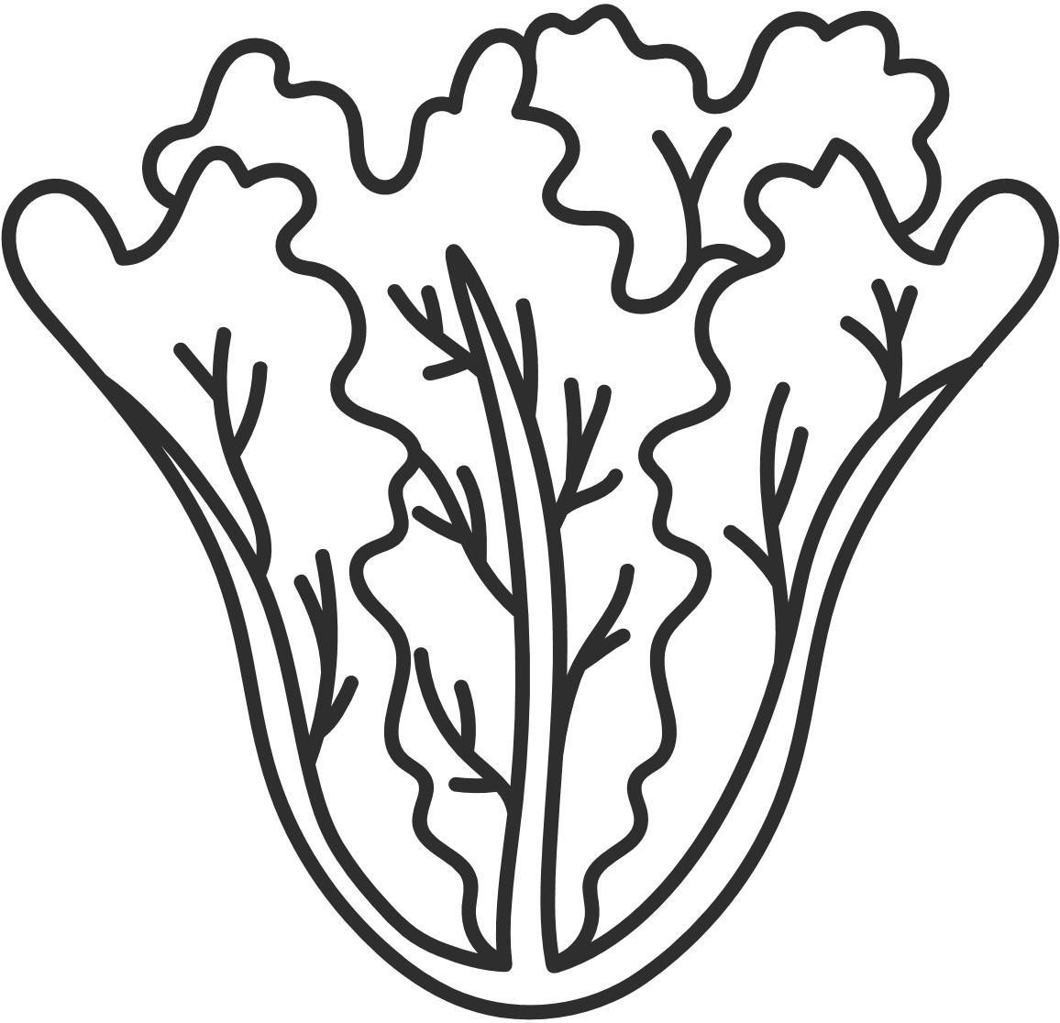

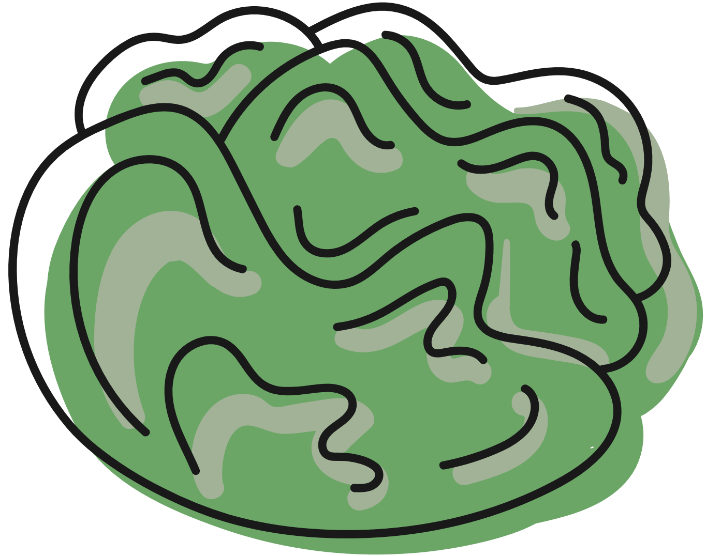
THANK YOU!
  Questions? Comments!
Notes:
Erica

Slide 25
Carvalho, D., Sequeira, C., Querido, A., Tomás, C., Morgado, T., Valentim, O., Moutinho, L., Gomes, J., & Laranjeira, C. (2022). Positive mental health literacy: A concept analysis. Frontiers in Psychology, 13, 877611. https://doi.org/10.3389/fpsyg.2022.877611
Costello, C. M., & Walters, M. E. (2021). Integrating resiliency into neurobiologically-focused mental health counseling through mindfulness. Journal of Creativity in Mental Health, 17(3), 350–362. https://doi.org/10.1080/15401383.2021.1892558
Cozolino, L. (2017). The neuroscience of psychotherapy: Healing the social brain (3rd ed.). W. W. Norton & Company.
Norcross, J. C., & VandenBos, G. R. (2018). Leaving it at the office: A guide to psychotherapist self-care, 2nd ed. The Guilford Press.
Rock, D., Siegel, D., Poelmans, S., & Payne, J. (2012). The Healthy Mind Platter. Neuroleadership Journal. 4, 1-23.
Sampaio, F., Gonçalves, P., & Sequeira, C. (2022). Mental health literacy: It is now time to put knowledge into practice. International journal of environmental research and public health, 19(12), 7030. https://doi.org/10.3390/ijerph19127030
Schore, A. N. (2021). The interpersonal neurobiology of intersubjectivity. Frontiers in Psychology, 12. https://doi.org/10.3389/fpsyg.2021.648616
Siegel, D. J. (2012). Pocket guide to interpersonal neurobiology: An integrative handbook of the mind. W. W. Norton & Company.
Siegel, D. J. (2019). The mind in psychotherapy: An interpersonal neurobiology framework for understanding and cultivating mental health. Psychology and Psychotherapy: Theory, Research and Practice, 92(2), 224–237. https://doi.org/10.1111/papt.12228
Siegel, D. J., & Drulis, C. (2023). An interpersonal neurobiology perspective on the mind and mental health: Personal, public, and planetary well-being. Annals of General Psychiatry, 22(1). https://doi.org/10.1186/s12991-023-00434-5

