Slide 1
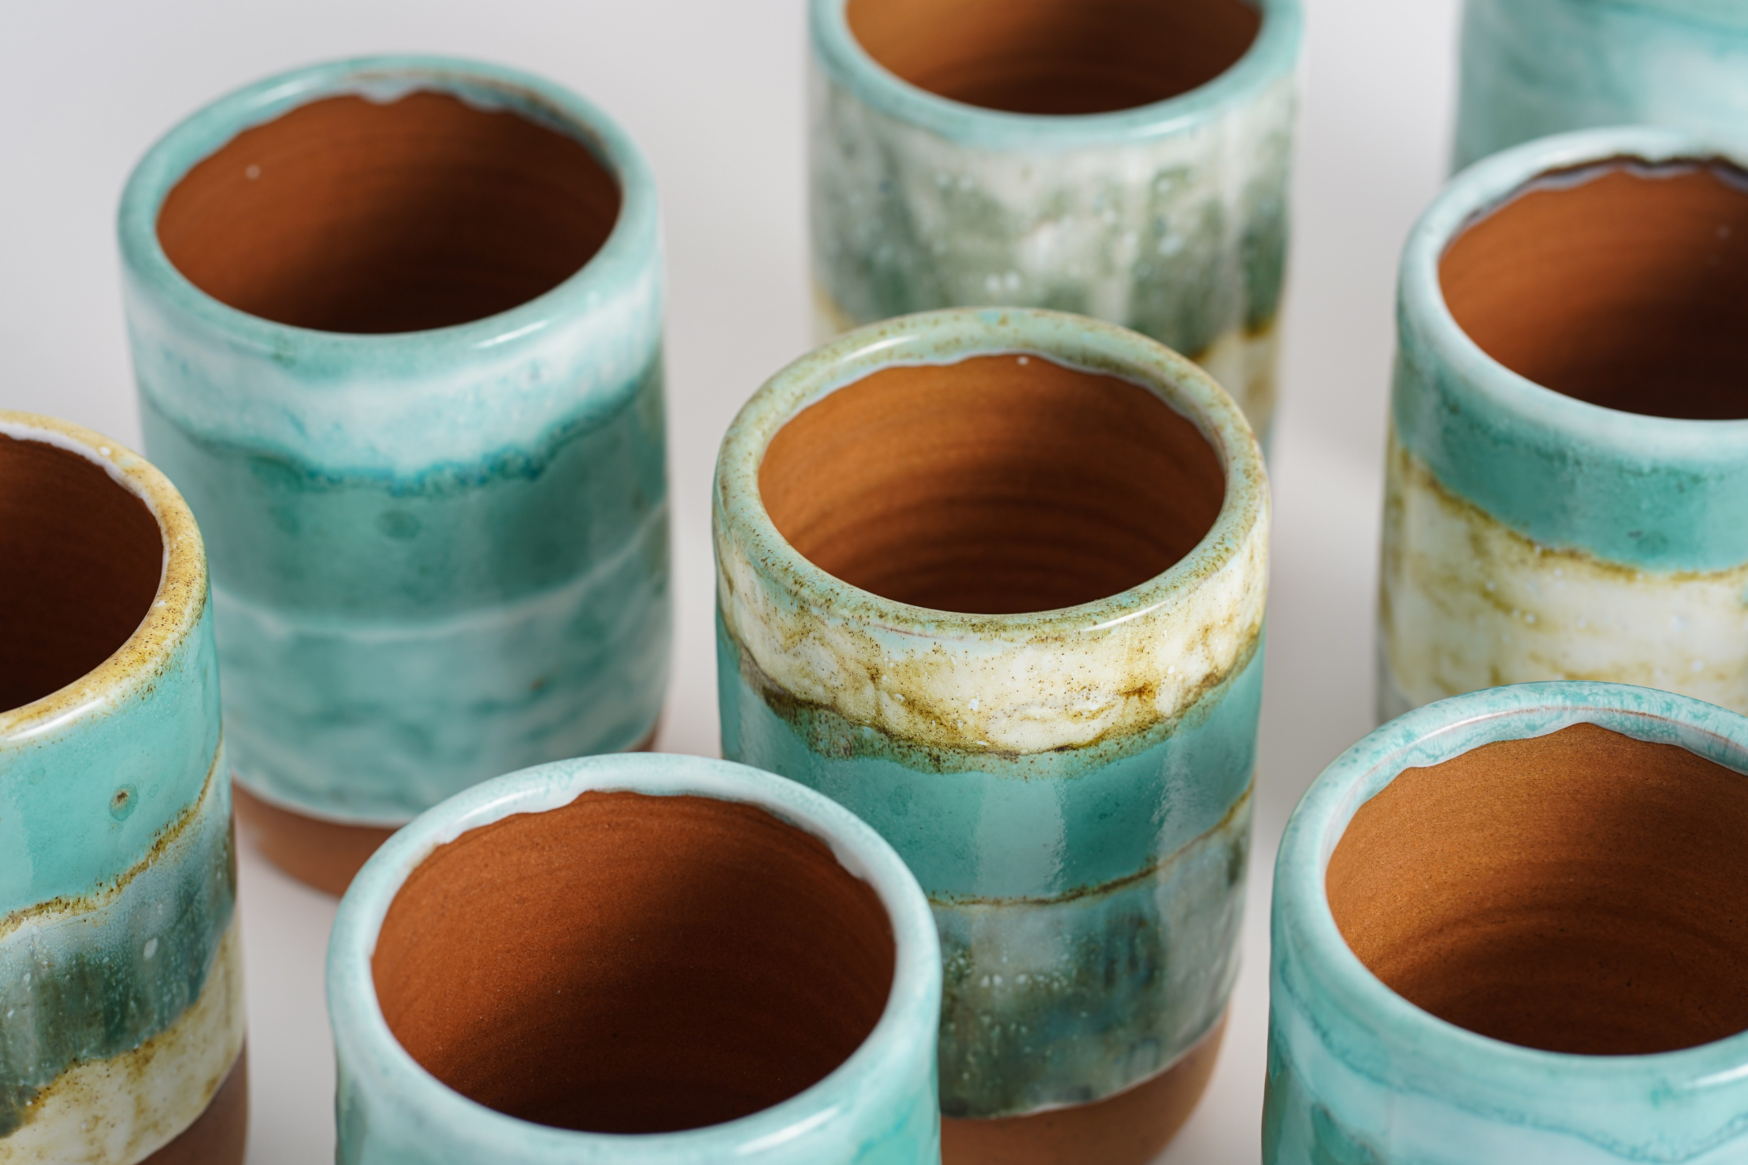
Check In
What would you say to yourself if you dropped your favorite mug and spilled hot liquid and broken pieces everywhere? (Comment in Chat)

Slide 2
Next
What would you say to your best friend if they dropped a favorite mug and spilled hot liquid and broken pieces everywhere?
(Comment in Chat)

Slide 3
Grace Filled
Self-Compassion
Dr. Erica Rhoads

Slide 4
Building Resilience through
Grace-Filled Self-Compassion
Identify problem of burnout and option of self care as means to build resilience
Recognize self-compassion practices within a biblical worldview as self-care option
Engage in an experiential activity to demonstrate the potential use of self-compassion spiritual practices.

Slide 5
Burnout
Burnout affects counselor performance, therapy outcomes, and the health and safety of clients (Davis, 2020; Gallup, 2020).
An estimated 40% of mental health professionals experience burnout (O’Connor et al., 2018)
The 2014 ACA code of ethics
Symptoms
Mental or physical exhaustion
Mental distancing from work
Cognitive Impairment
Emotional Impairment
      (Shaufeli et al., 2023).
C.2.g. Impairment …counselors monitor themselves for signs of impairment…and refrain from offering or providing professional services when impaired… (prevention of Impairment)

Slide 6
CACREP 3.A.11
Part of Professional Counseling Orientation includes:
self-care, self-awareness, and self-evaluation strategies for ethical and effective practice
Self-compassion can be a “buffer against self-critical attitudes” (Voon et al., 2022, p1), leading to increased resilience and psychological well-being.

Slide 7
Self Compassion Framework
(Neff, 2023)
Isolation vs Common Humanity
Self Judgement vs Self Kindness
Overidentification vs Contemplative Mindfulness

Slide 8
Easy on Myself by Emily Cook https://open.spotify.com/track/25tjoZf9bQux8KyxerIOb5
As you listen to the song, note what stands out to you from the lyrics

Slide 9
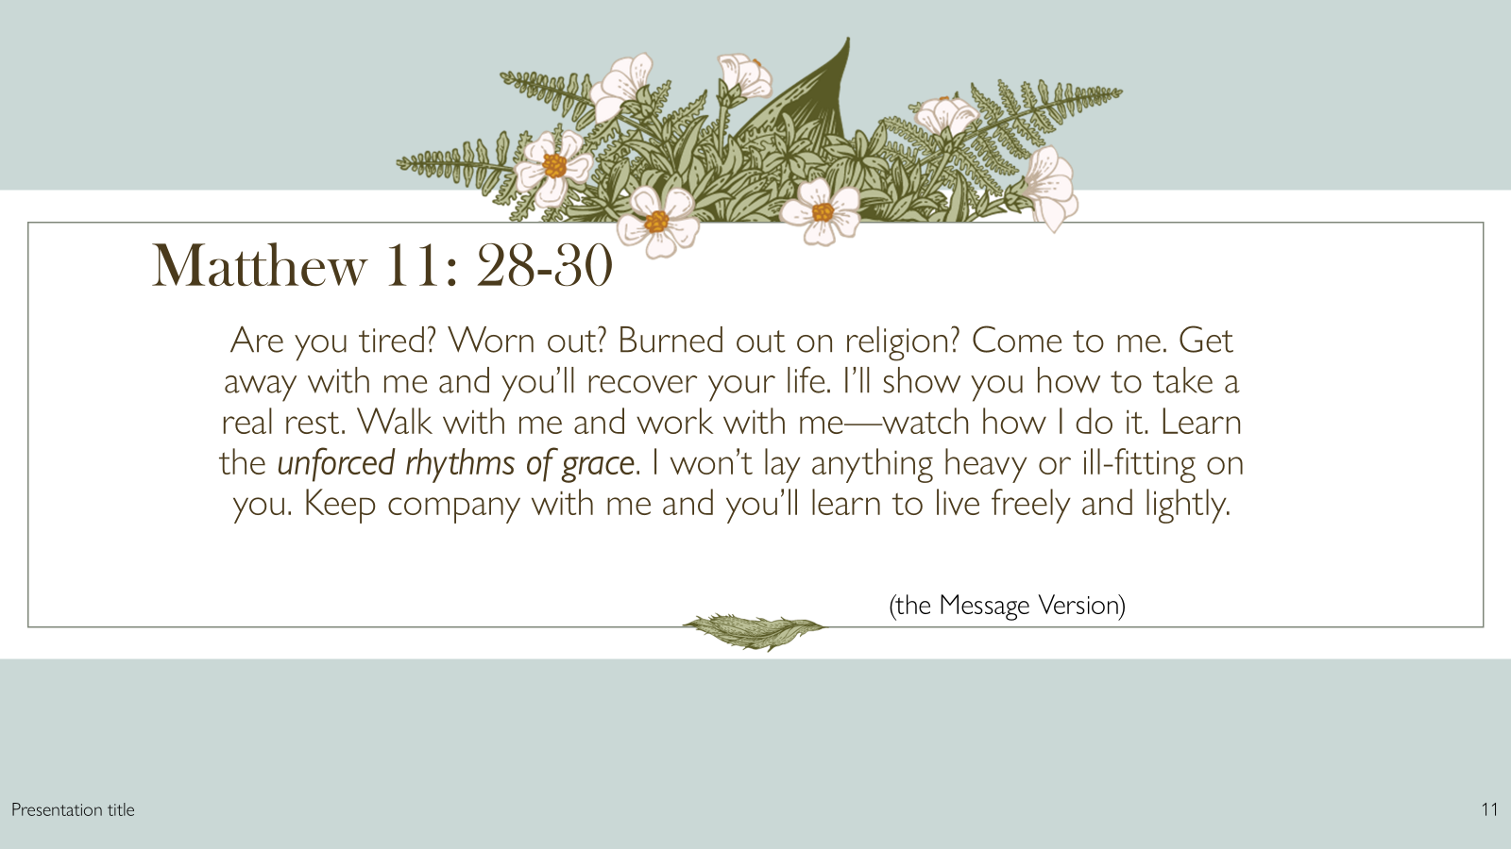
Grace as a base for Self-Compassion
As we grow in our ability to feel safe and secure in God’s love for us, we can extend this love toward ourselves (Wilhoit, 2019).

Slide 10
Self Kindness vs Self Judgement
  Believe that God is gentle, kind, loving and forgiving
  See ourselves the way God sees us: made in the image of God, fearfully and wonderfully made
  Understanding and accepting the compassion of Christ who loved us, died for us and longs to forgives us and reconcile us to God
  Believe that it is supernatural: the Holy Spirit places the Love of God within the believer (Kindness is a fruit of the Spirit)
  View God as dismissive, punitive and condemning
  Evaluate moral and spiritual worth based on alignment with religious scrupulosity
  Rigid and fear driven to achieve “holiness” through our own efforts
  Shame based motivation to drive us to prove our value and worth by listening to the accuser’s lies
      Carter et al., 2023; Wilhoit 2019

Slide 11
Common Humanity vs Isolation
  Understand that God recognizes that we are dust
  Suffering is part of our walk with Christ to join in His sufferings and make us more Christlike
  God is relational and we are called to unity, community, and shared relationships
  Jesus demonstrated community with his disciples
  We are to bear one another’s burdens
  One of God’s first “not good” was that it was not good for man to be alone.
  We are more easily tempted when alone. Satan chose to tempt Jesus when he was isolated in the desert
  When the accuser alienates us from the body, it is easier to question beliefs and feel unworthy of acceptance
  Alone we are more vulnerable to pain and sorrow
      Carter et al., 2023, Wilhoit 2019

Slide 12
Contemplative Mindfulness vs Over-Identification
  Using the truth of scripture to take thoughts captive and renew our mind
  Meditating on God’s word
  Abiding in the God to be sensitive to the Holy Spirit’s leading and correction
  Does not excuse sin, but provides compassionate accountability
  Recognizes our attachment to God and seek Him to attune and regulate the pain of presence and the pain of absence
  Allowing our sins to define us rather than taking on our New Identity in Christ
  Recognize that suffering does note equate with punishment or determining our value to God
  We can look to other examples of people who suffered for their faith and pleased God
  Focusing on moral failures by striving for moral perfection, leads to scrupulosity and shame
      Carter et al., 2023, Wilhoit 2019
Notes:
2 Corinthians 7:10 in the New King James Version (NKJV), "For godly sorrow produces repentance leading to salvation, not to be regretted; but the sorrow of the world produces death."

Slide 13
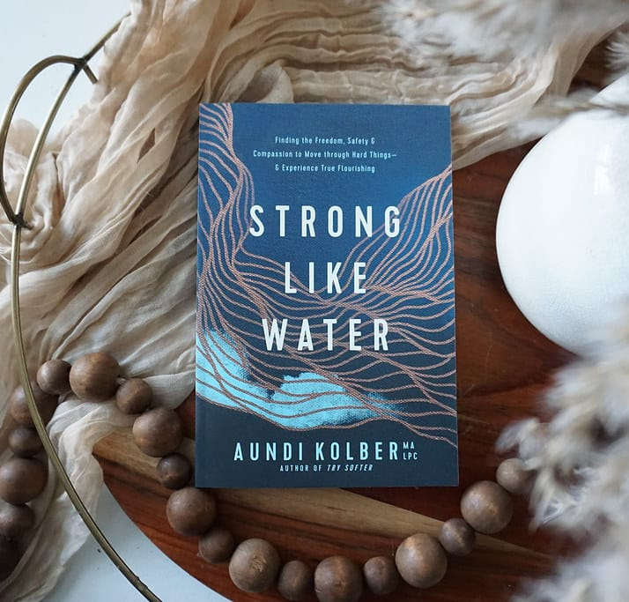
Experiential Exercise
Breathe
Ground
Connect
Give Compassionate Grace

Slide 14

Who needs this?
Counselors in training
Counselors in practice
Educators
Clients

Slide 15

SMART Goals
memorize scripture on love and kindness
accountability partner
…other suggestions?

Slide 16
References
American Counseling Association. (2014). 2014 ACA code of ethics.
https://www.counseling.org/docs/default-source/default-document-library/ethics/2014-aca-code-of-ethics.pdf
CACREP. (2024). CACREP standards (2024 version).
Carter, M. D. K., Blalack, J. L., & King, K. L. (2023). The narration and introduction of a Christian self-compassion intervention. Journal of Psychology and Christianity, 42(4), 322–344.
Davis, P. (2020). The impact of burnout. Retrieved from
https://stressandresilience.com/burnout/.
Gallup. (2020). Gallup’s perspective on employee burnout: Causes and cures.
Washington, DC: Gallup World Headquarters.
Neff, K. D. (2023). Self-compassion: Theory, method, research, and intervention. Annual Review of Psychology, 74, 193–218. https://doi.org/10.1146/annurev-psych-032420-031047
O'Connor K., Muller Neff, D.M, & Pitman S. (2018). Burnout in mental health professionals: A systematic review and meta-analysis of prevalence and determinants. European Psychiatry. Sep;53:74-99. doi: 10.1016/j.eurpsy.2018.06.003.
Schaufeli, W. B., Hakanen, J. J., & Shimazu, A. (2023). Burning questions in burnout research. In N. De Cuyper, E. Selenko, M. Euwema, & W. Schaufeli (Eds.), Job insecurity, precarious employment and burnout (pp. 127–148). Elgar. doi:/10.4337/9781035315888.00017
Voon, S. P., Lau, P. L., Leong, K. E., & Jaafar, J. L. S. (2022). Self-compassion and psychological well-being among Malaysian counselors: The mediating role of resilience. The Asia-Pacific Education Researcher, 31(4), 475-488. doi:/10.1007/s40299-021-00590-w.
Wilhoit, J. (2019). Self-Compassion as a Christian Spiritual Practice. Journal of Spiritual Formation & Soul Care, 12(1), 71–88. https://doi.org/10.1177/1939790918795628

